Slide 1
NERC Quarterly Technical Session
May 8, 2024

Slide 2
Introduction and Opening Remarks
NERC Antitrust Compliance Guidelines

Slide 3
Electricity Load Projections for the Energy Transition
Tom Wilson, Ph.D.
Principal Technical Executive, Energy Systems and Climate Analysis
NERC Quarterly Technical Session, Washington, DC
May 8, 2024

Slide 4
EPRI
Leading Global Collaborative Energy R&D
Independent
Non-Profit
EPRI is advancing energy technologies and informing decision-making through ~$450M in collaborative annual research with more than 450 entities in 45 countries – spanning the production, delivery, and use of energy.
Collaborative
www.EPRI.com

Slide 5



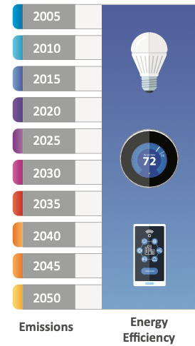


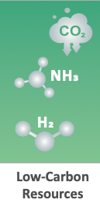
THE ELECTRIC SECTOR
A Leader in Economywide Decarbonization
The electric sector is driving decarbonization across an increasingly electrified economy.

Slide 6
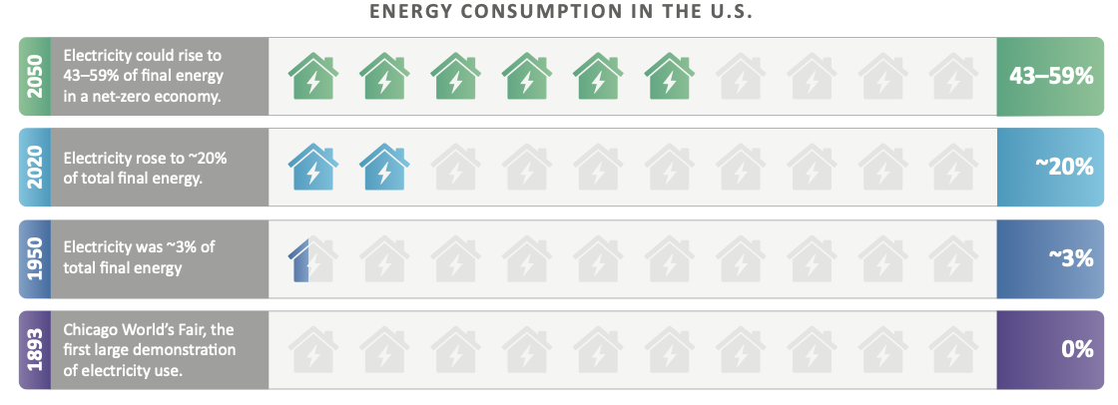
THE ELECTRIC SECTOR
A Leader in Economywide Decarbonization
The electric sector is driving decarbonization across an increasingly electrified economy.

Slide 7
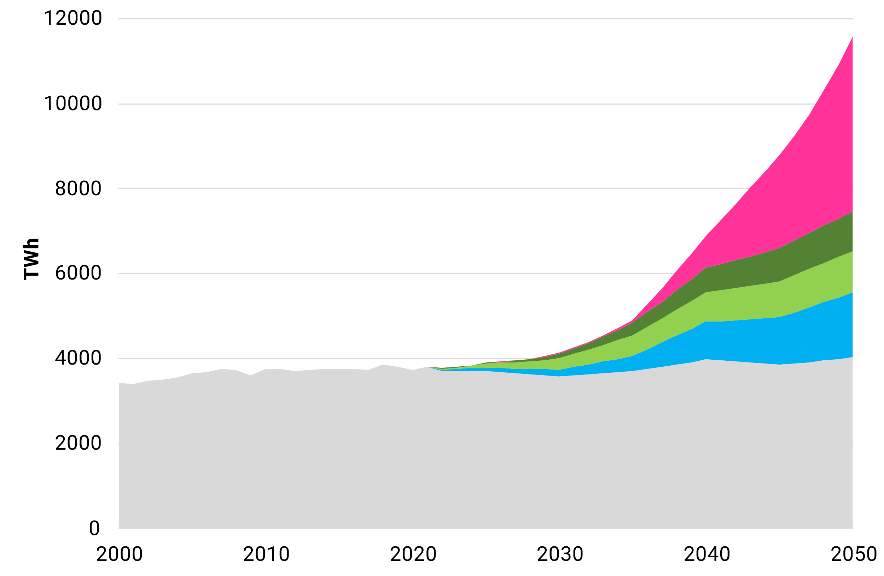
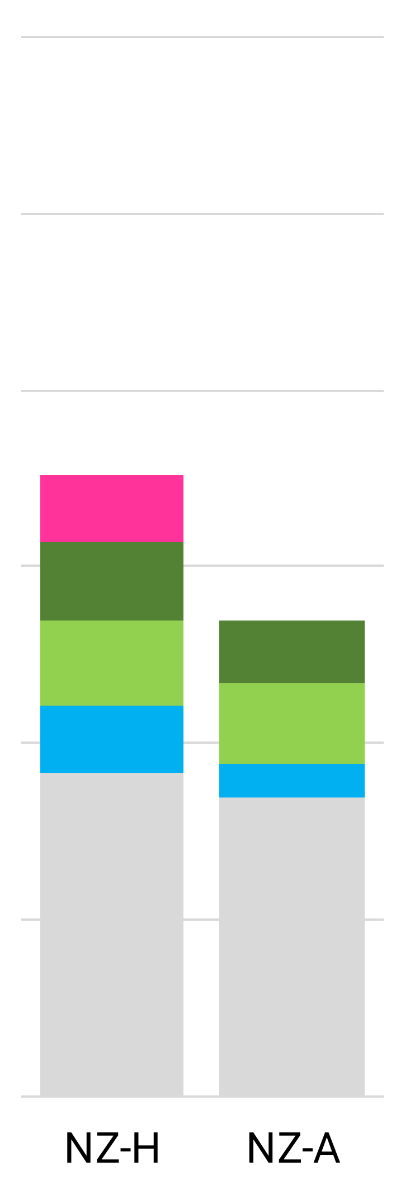
Decarbonization Drives Electric Load Growth
U.S. Electricity Demand:
Net-Zero Limited Options
Alternative Net-Zero 2050 Scenarios
Higher Fuel Cost (NZ-H)
All Options (NZ-A)
Hydrogen Fuel Production
Medium- and Heavy-Duty Transport
Light-Duty Vehicles
Buildings + Industrial Electrification
Existing Uses
Historical load from EIA SEDS dataset
Projected load based on scenarios in LCRI Net-Zero 2050 report

Slide 8
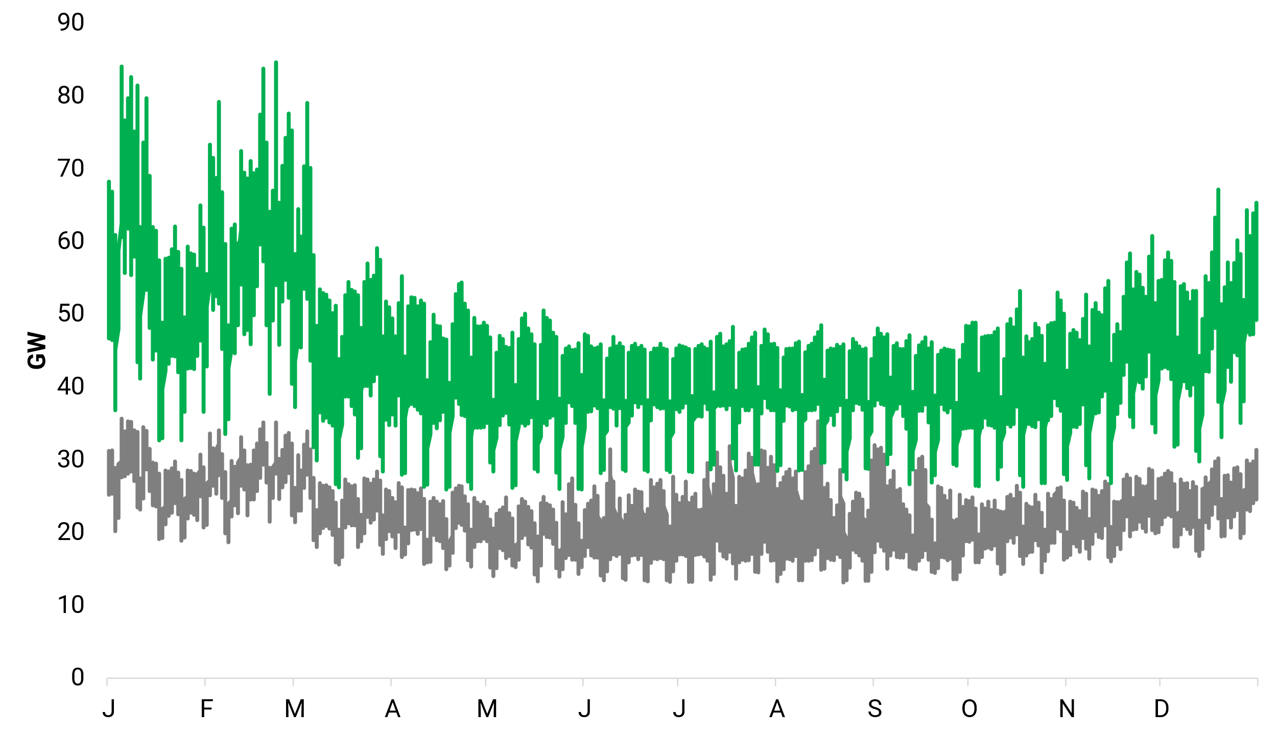
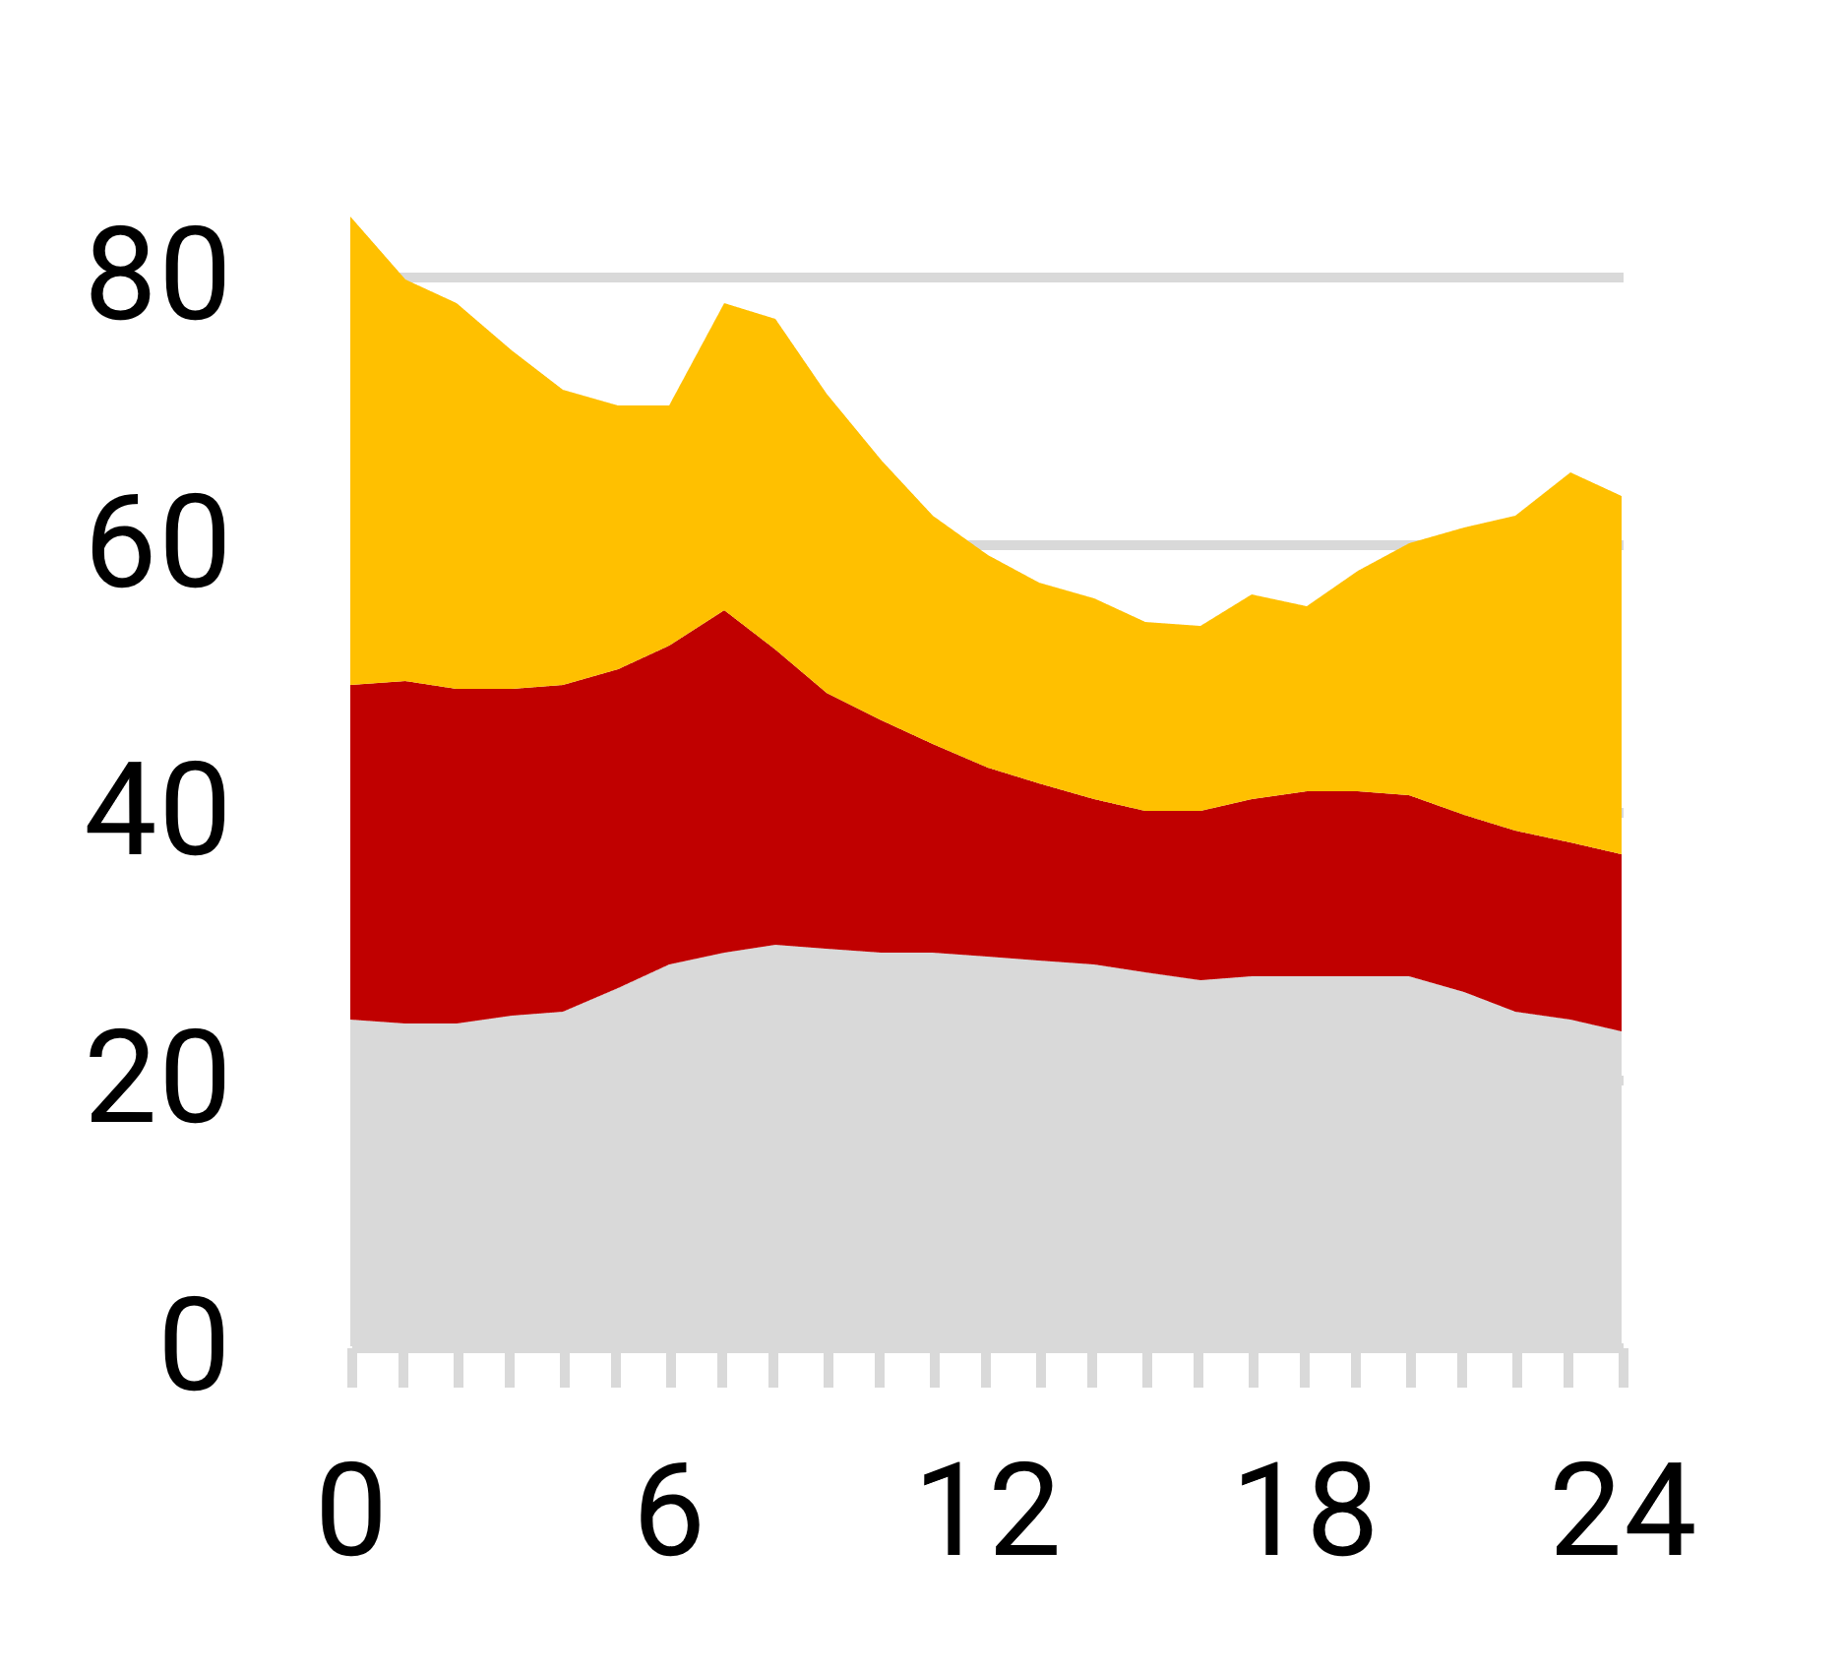
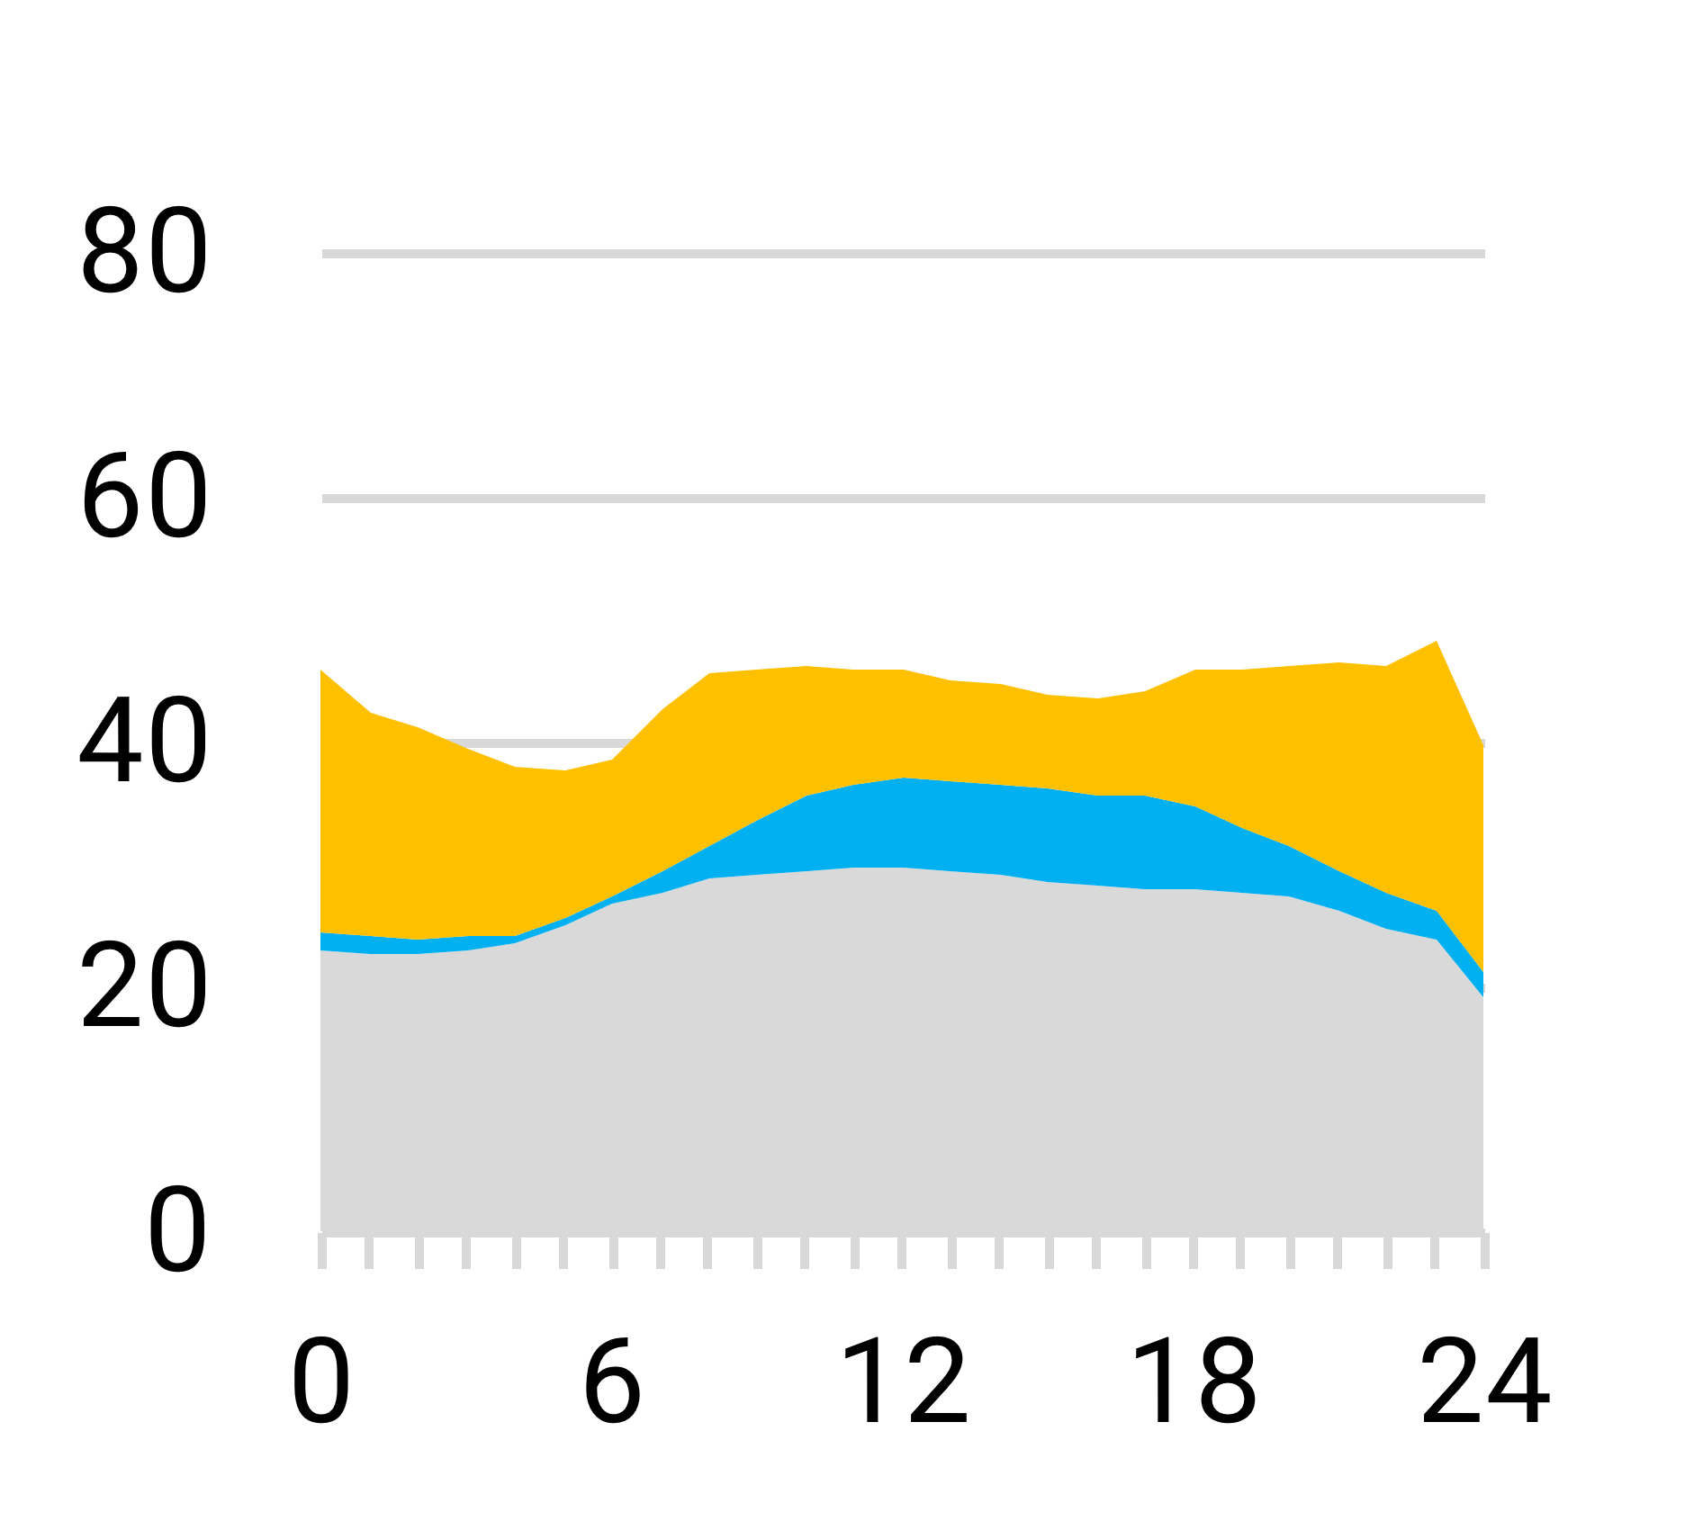
Efficiency and Electrification Drive Load Shifts
MISO-N
38% of peak heating demand
2050
Net-Zero Limited Options
Vehicle Charging
Space Heating
Vehicle Charging
Non-Seasonal
Cooling
Non-Seasonal
2015
*Excludes electrolysis load

Slide 9
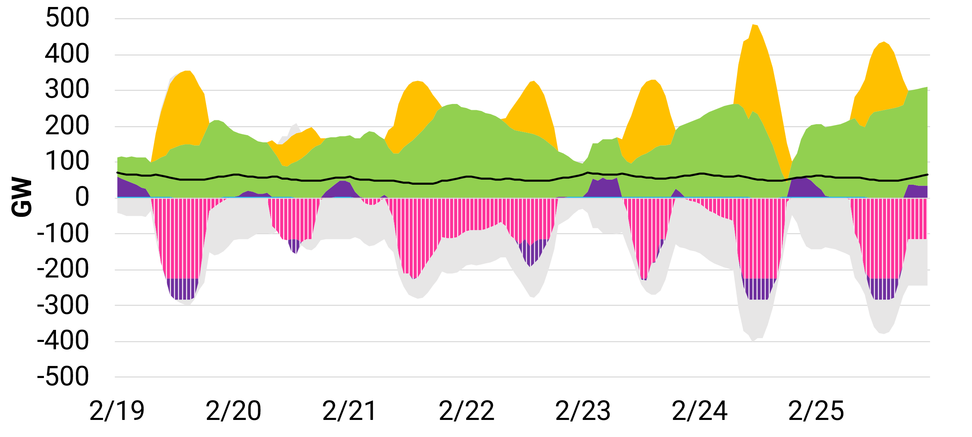
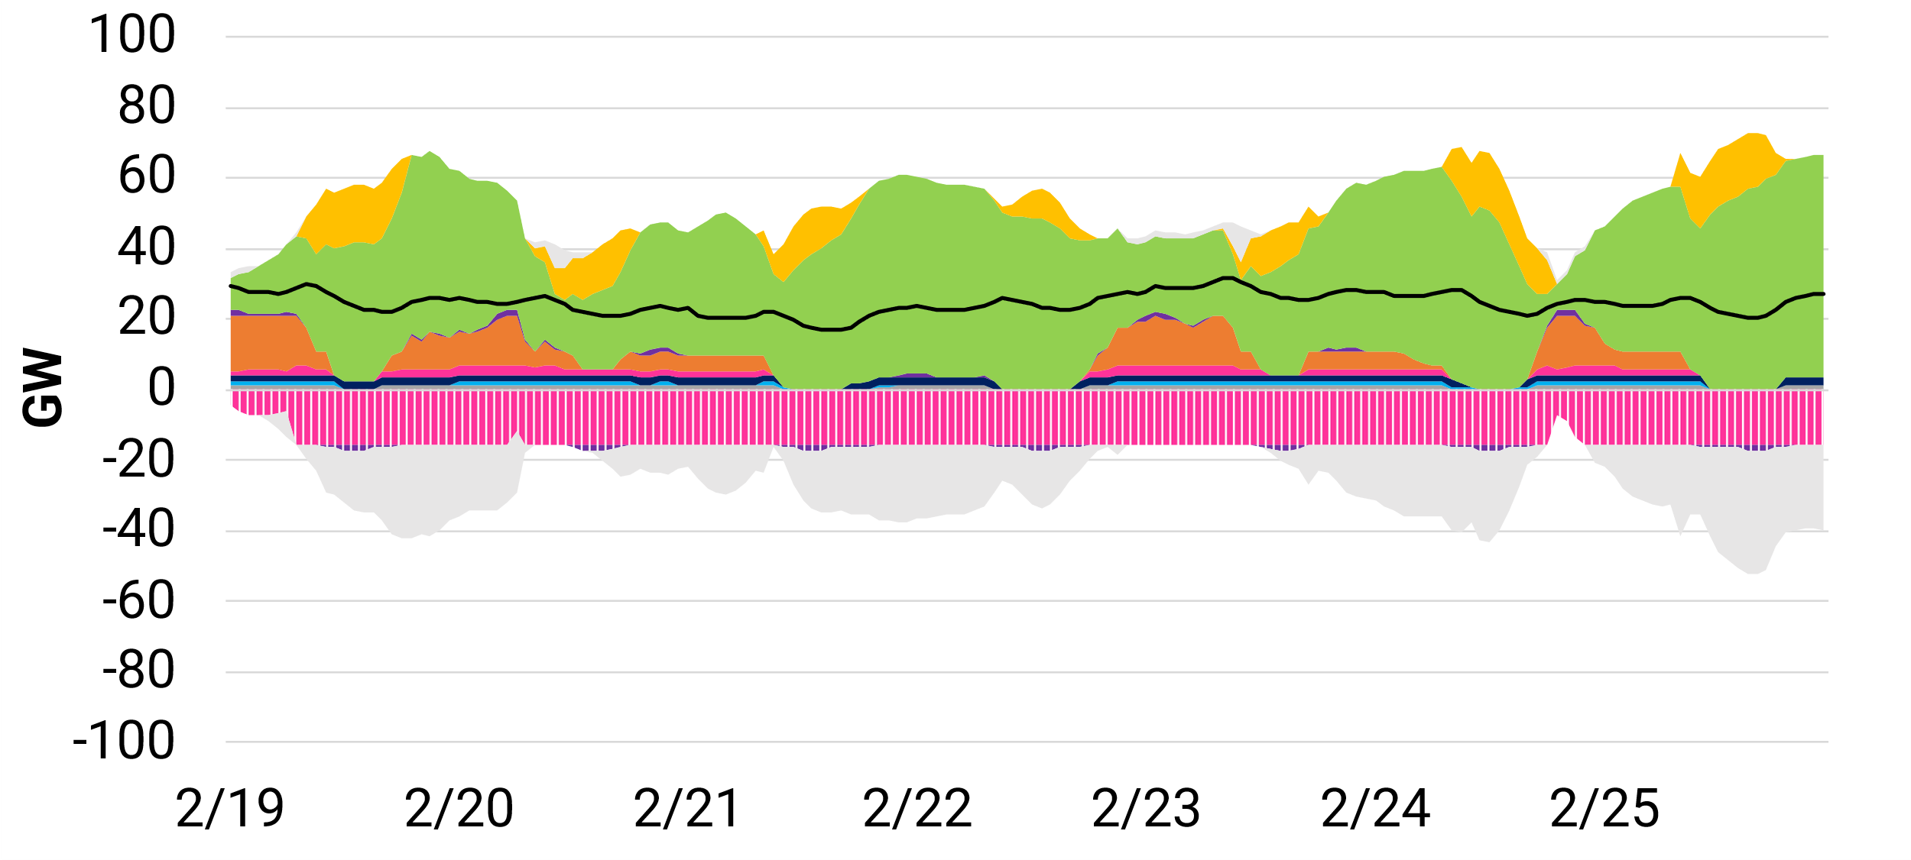
Electrolysis Load Profile System Impacts
SPP
Economy-wide CO₂ target leads to variable electrolysis production, generally aligned with renewable output
Net Imports
2050 Net-Zero Limited Options Scenario
Solar
Wind
Storage Discharge
Gas
Hydrogen
Gas-CCS
Coal
Bio/Other
Bio-CCS
Hydro
Nuclear
45V tax credit leads to near-constant electrolysis production, even with hourly matching requirement
Electrolysis (high-temp)
2035 IRA + 45V Scenario
Electrolysis (PEM)
Storage Charge
Net Exports
End-use Load
Hourly Dispatch (sample week)
45V scenario report: Impacts of IRA's 45V Clean Hydrogen Tax Credit

Slide 10
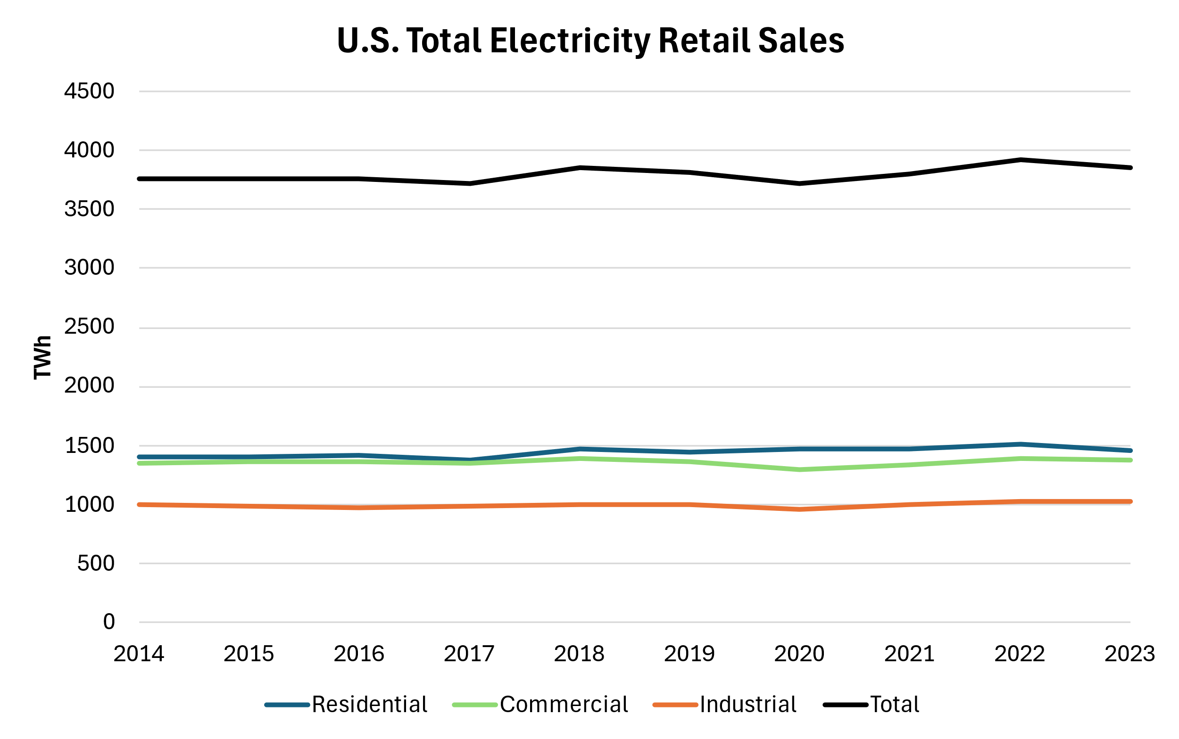
What Are We Seeing Today (through December 2023)?
Historical load from EIA Monthly Energy Review

Slide 11
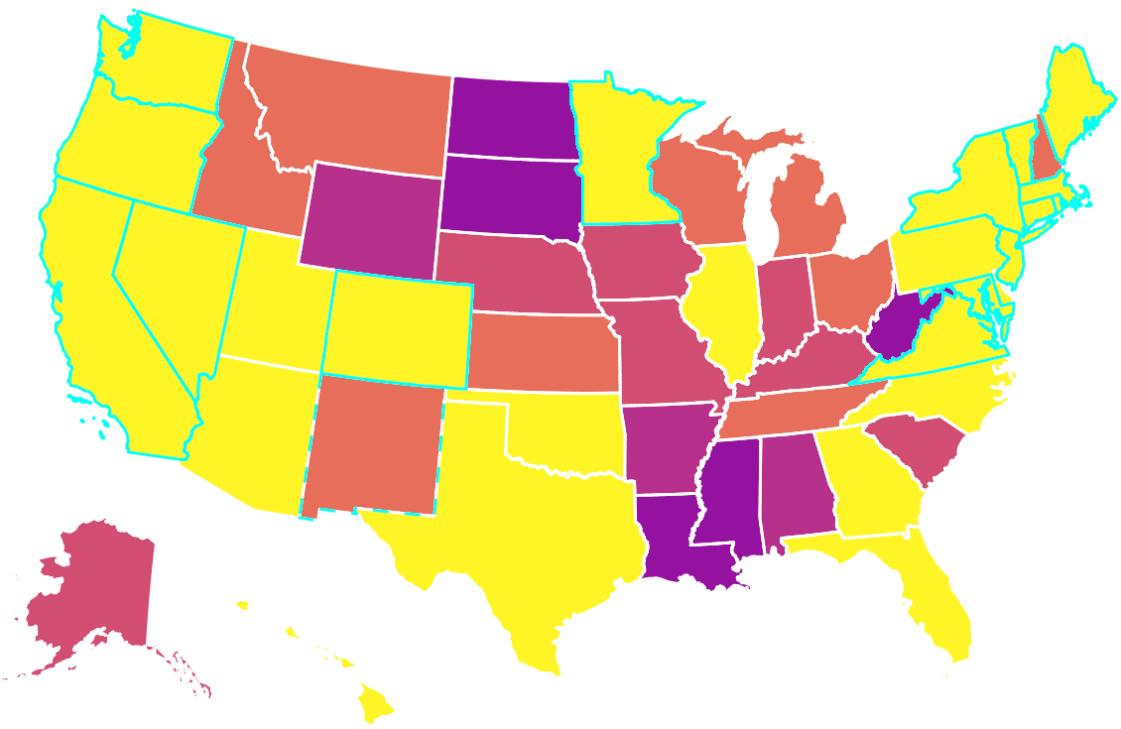
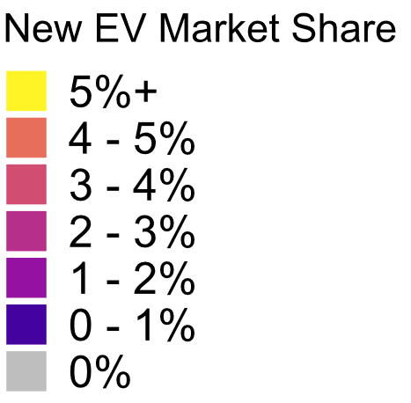
EVs are Coming - New EV Market Share by State (Jan. – Feb. 2024)
Nationwide avg new EV market share: 9.0%
Number of states exceeding avg: 15
Number of states with counties exceeding avg: 39
Top 20 states | New EV market share | New EV market size
District of Columbia | 22.9% | 629
California | 22.6% | 65,623
Washington | 18.5% | 9,021
Colorado | 17.8% | 7,952
Hawaii | 17.1% | 1,864
Oregon | 15.7% | 4,694
Nevada | 13.9% | 3,121
Maryland | 12.4% | 6,264
Vermont | 11.0% | 653
Massachusetts | 10.4% | 2,653
New York | 10.0% | 13,357
Delaware | 9.6% | 731
New Jersey | 9.3% | 7,545
Connecticut | 9.3% | 2,050
Utah | 9.1% | 2,026
Arizona | 8.7% | 4,603
Virginia | 8.1% | 4,768
Rhode Island | 7.3% | 495
North Carolina | 7.1% | 5,273
Texas | 7.0% | 18,813
ZEV state
Future* ZEV state
  The viewpoints expressed in this presentation are those of EPRI and do not necessarily reflect the positions or perspectives of individual members or advisory organizations.

Slide 12
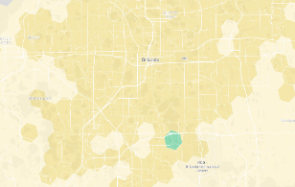
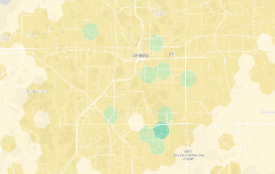
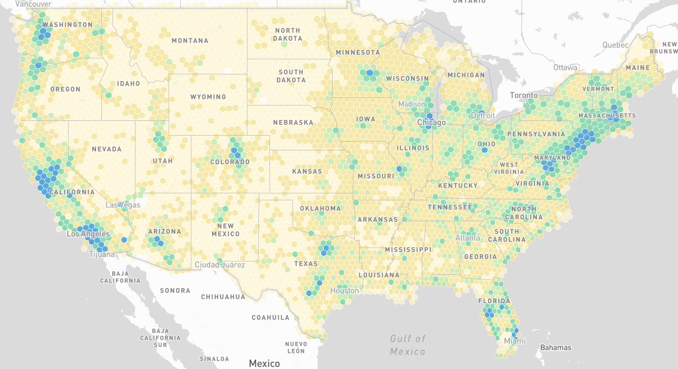
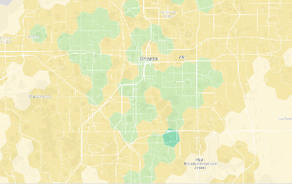
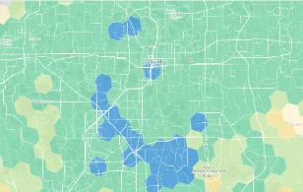
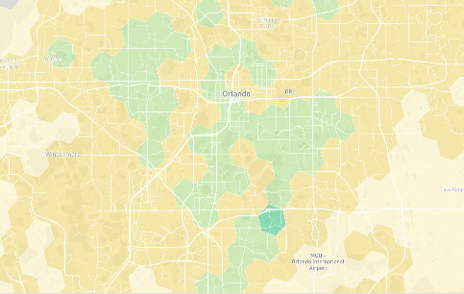
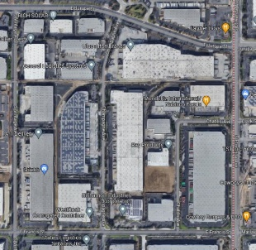
eRoadMAP: Interactive Load Map to Hex8 Resolution (0.28 mi²)
General Problem to be Addressed
Where and when will loads appear on the grid?
Fleet Electrification Over Time
https://eroadmap.epri.com/
2024
2026
2028
100%
Fleet activity aggregated to Hex8 Level
(protects proprietary fleet data)

Slide 13
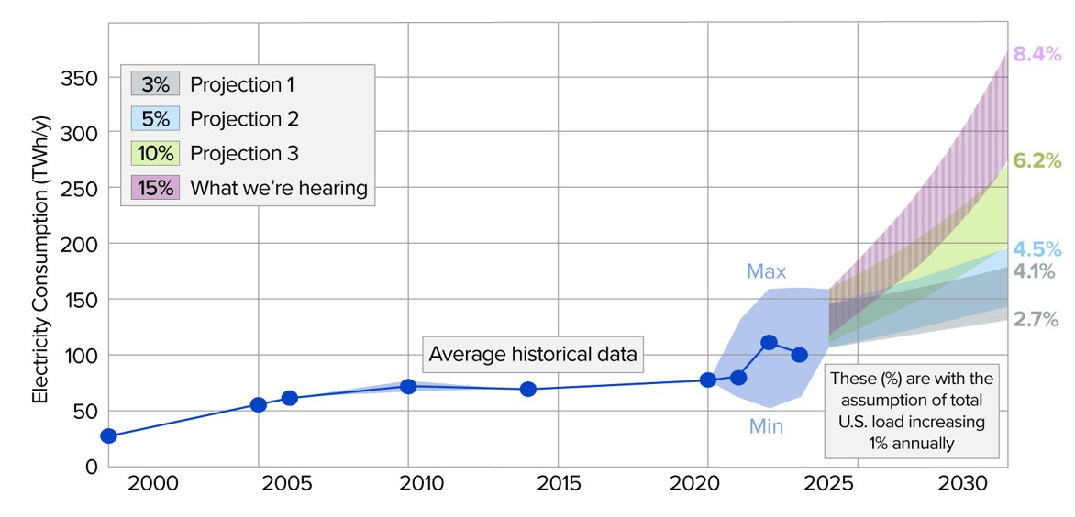
Data Centers are Coming – Can They Be a Grid Resource?
Preliminary analysis – EPRI Forthcoming

Slide 14



EPRI Load Forecasting Initiative
Industry Coordination
Enable knowledge-sharing and
collaboration among utilities, ISOs/RTOs, etc.
Long-Term Forecasting
(Planning)
Develop methodologies and
guidance to incorporate new load drivers
Short-Term Forecasting
(Operations)
Develop methodologies and guidance to mitigate changes in forecast accuracy
Goal: Address critical needs to improve load forecasts for both planning and operations
Contact: David Larson, dlarson@epri.com

Slide 16
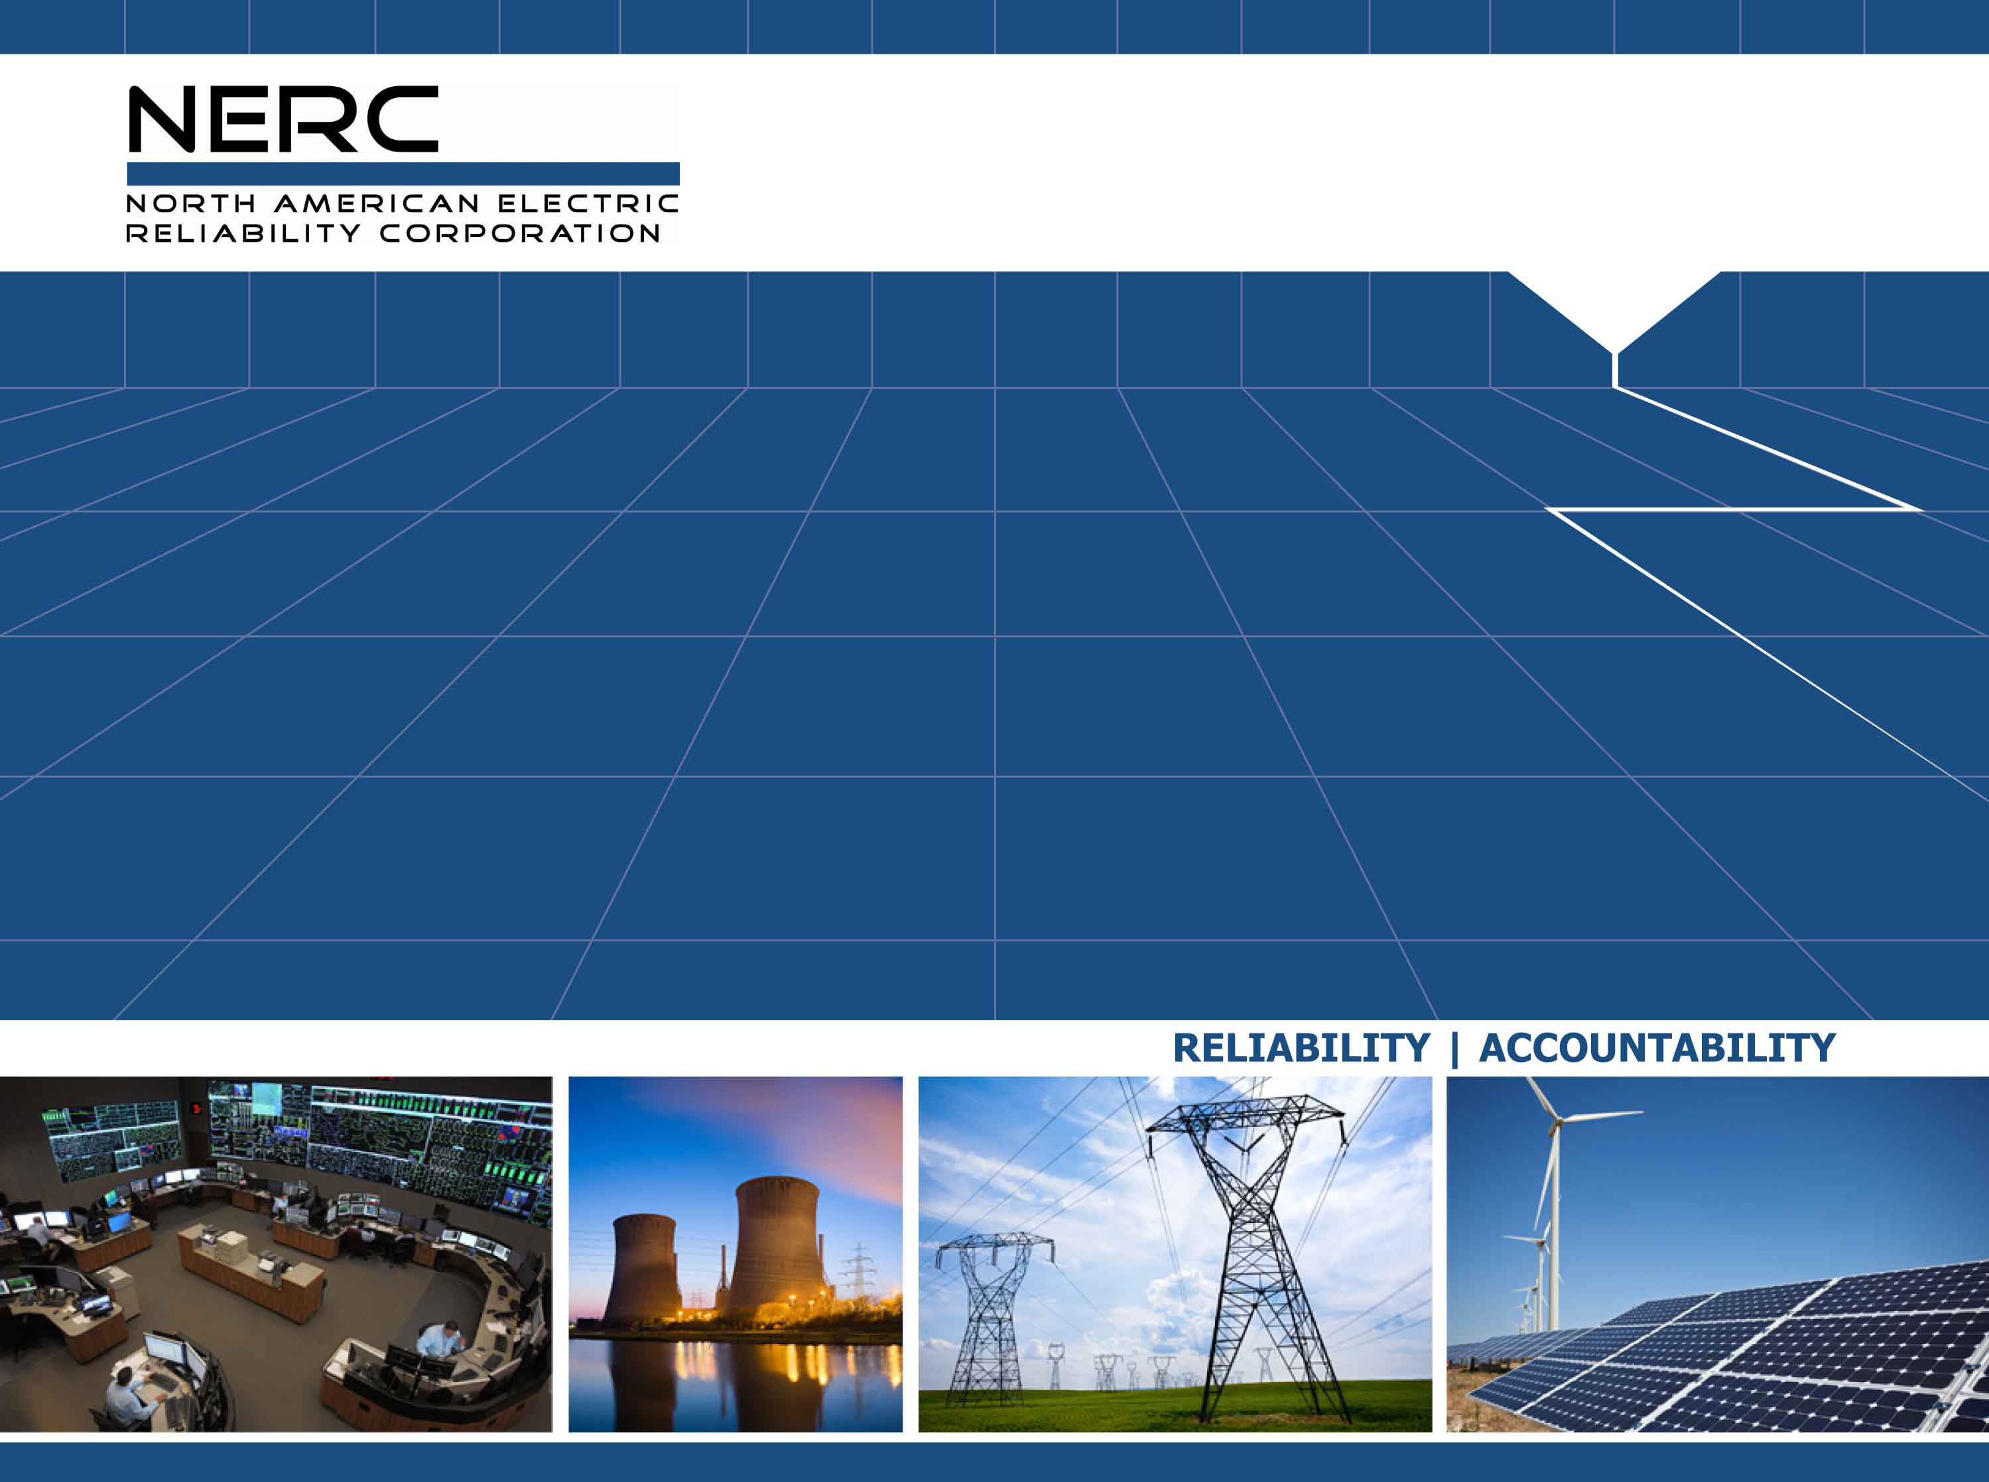
2024 Summer Reliability Assessment Preview
Status and Preliminary Findings (Updated May 7, 2024)
John Moura, Director, Reliability Assessment and Performance Analysis
Board of Trustees Technical Session
May 8, 2024

Slide 17
Key Takeaways
All areas have adequate resources for normal summer demand
  Aided by new wind, solar, and battery resources and delaying generator retirements in areas with adequacy issues
  Growth in demand-side management programs are an added resource
System operators in parts of North America can expect challenges with supply sufficiency during extreme temperatures
  Areas with high solar PV can have energy risks during evening periods
Strong demand growth is contributing to resource and transmission adequacy concerns in several areas
Resource and transmission projects that can help prepare for summer should be monitored for supply chain issues

Slide 18
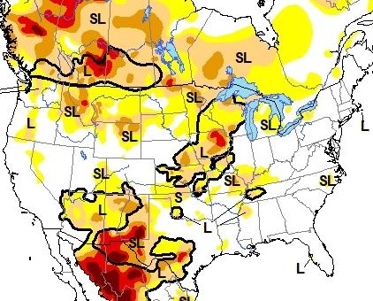
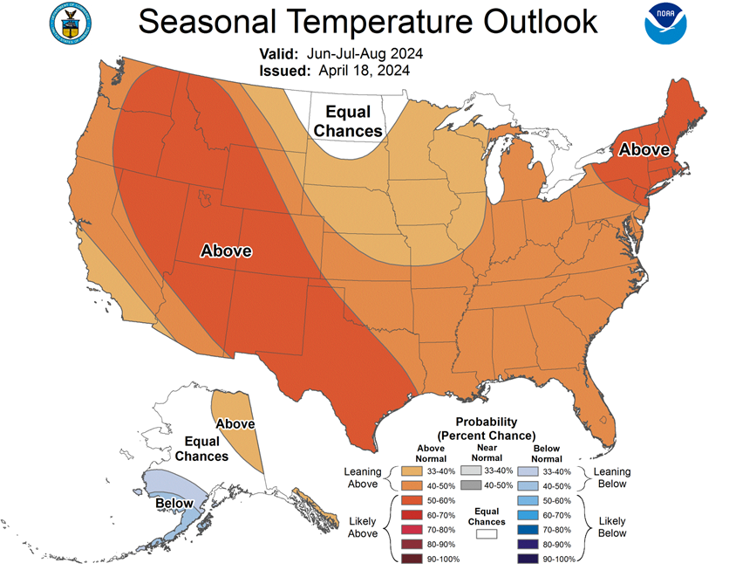
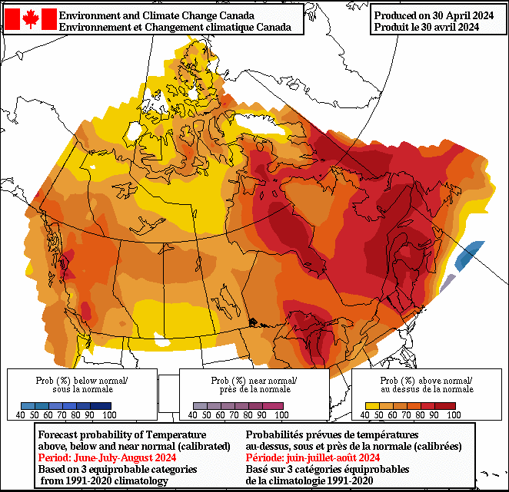
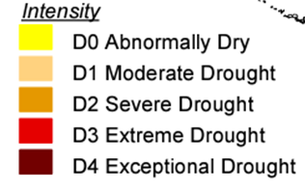
Summer Temperature and Drought Outlook
Above average temperatures expected across North America
Drought conditions across Canada and in the U.S. Southwest can contribute to high temperatures and impact generation
3-Month Temperature Outlook (U.S. National Weather Service, Environment and Climate Change Canada) and April North American Drought Monitor (NADM)

Slide 19
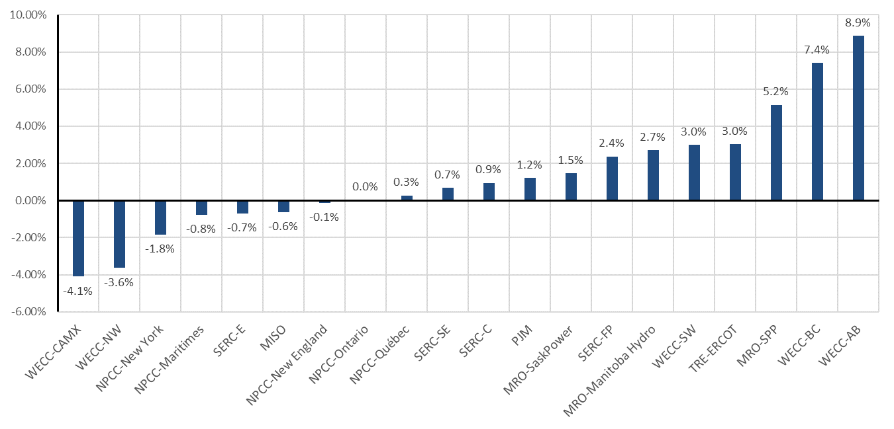
Summer Peak Demand Forecast Changes |Year-to-Year
Higher peak demand forecasts in more areas than past summers
Clear growth trend despite some yearly variation in forecasts
Consecutive years with strong growth
Strong growth forecast from last summer is moderated this year

Slide 20
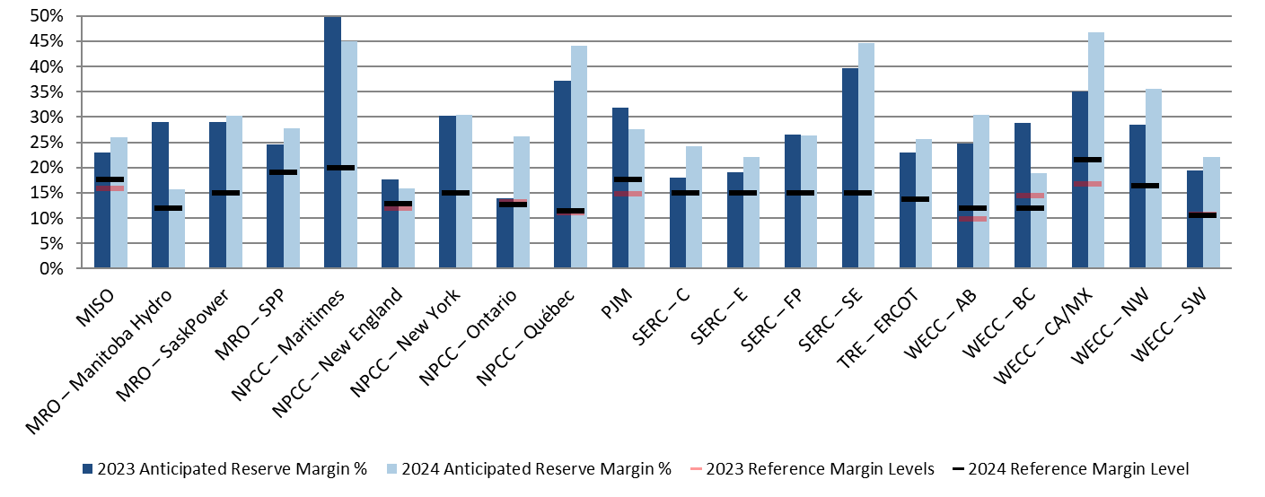
Reserve Margin Changes
New resources and Demand Response (DR) have increased available capacity in risk areas from last summer
SPP: Wind additions and new committed capacity
Ontario: Nuclear unit availability, firm imports
SERC Central: firm imports, natural gas and solar additions
U.S. West: Solar and battery additions, hydro outlook (CA)
Summer 2023 and Summer 2024 Anticipated Reserve Margins Year-to-Year Change

Slide 21
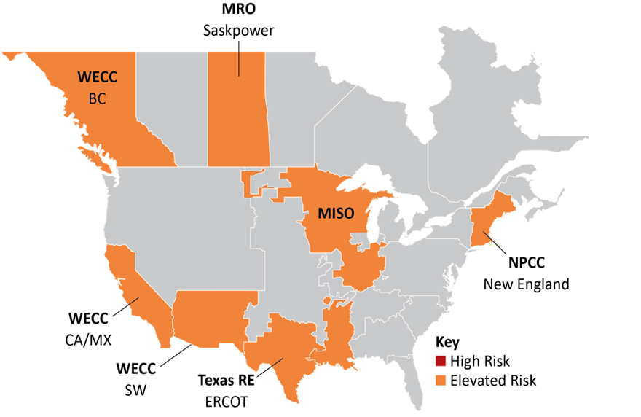
2024 Summer Reliability Assessment Highlights
Supply shortages anticipated during extreme summer conditions
Capacity and Energy Risk Assessment inputs:
  On-peak reserve margins
  Operational risk analysis
  Probabilistic energy metrics
Assessed extreme conditions include 90/10 demand, historical high generator outages, and low wind and solar scenarios
2024 Summer Reliability Risk Map
Seasonal Risk Assessment Summary
High | Potential for insufficient operating reserves in normal peak conditions
Elevated | Potential for insufficient operating reserves in extreme conditions
Normal | Sufficient operating reserves expected

Slide 22
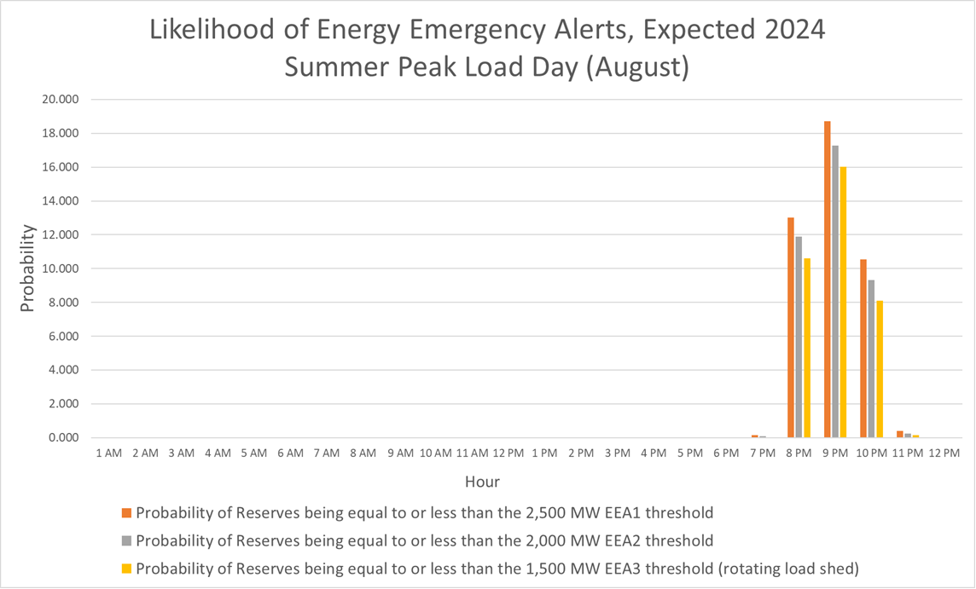
Energy Risks
All-hours probabilistic analysis and deterministic scenarios identify energy risks
Risk of EEAs in evening as solar generation ramps down
Low risk up to and including time of peak demand (5 p.m.)
ERCOT Probabilities of Energy Emergencies for Projected Peak Day (Summer 2024)
Chart Source: ERCOT

Slide 23
Recommendations
Reliability Coordinators, Balancing Authorities, and Transmission Operators in elevated risk areas review operating plans and protocols for resolving supply shortfalls
  Employ conservative outage coordination procedures
  Engage state or provincial regulators and policymakers to prepare for efficient implementation of demand side management mechanisms
Generator Owners with solar PV resources implement recommendations in NERC’s Inverter-Based Resource Performance Issues Alert (Level 2)
State regulators and industry should have protocols in place at the start of summer for managing emergent requests for generator air-quality waivers during periods of high demand

Slide 24
SRA Schedule
Date | Milestone
April | Draft report provided to the RSTC for review and comments
Early May | Final report sent to NERC Leadership for approval
May 10 | Report sent to NERC Board
May 14 | Report sent to ERO Executive Committee and MRC
May 15 | Report Release and Industry Webinar
Communication Plan
  Media Webinar and Interviews
  Announcement / Video / Social Media
Outreach and Engagement
  State/Provincial – NASEO, NARUC, Regional Entity regulator outreach
  Federal – FERC, DOE, Legislative
  Industry – Webinar, RSTC, and Regional Entity technical committees

Slide 25
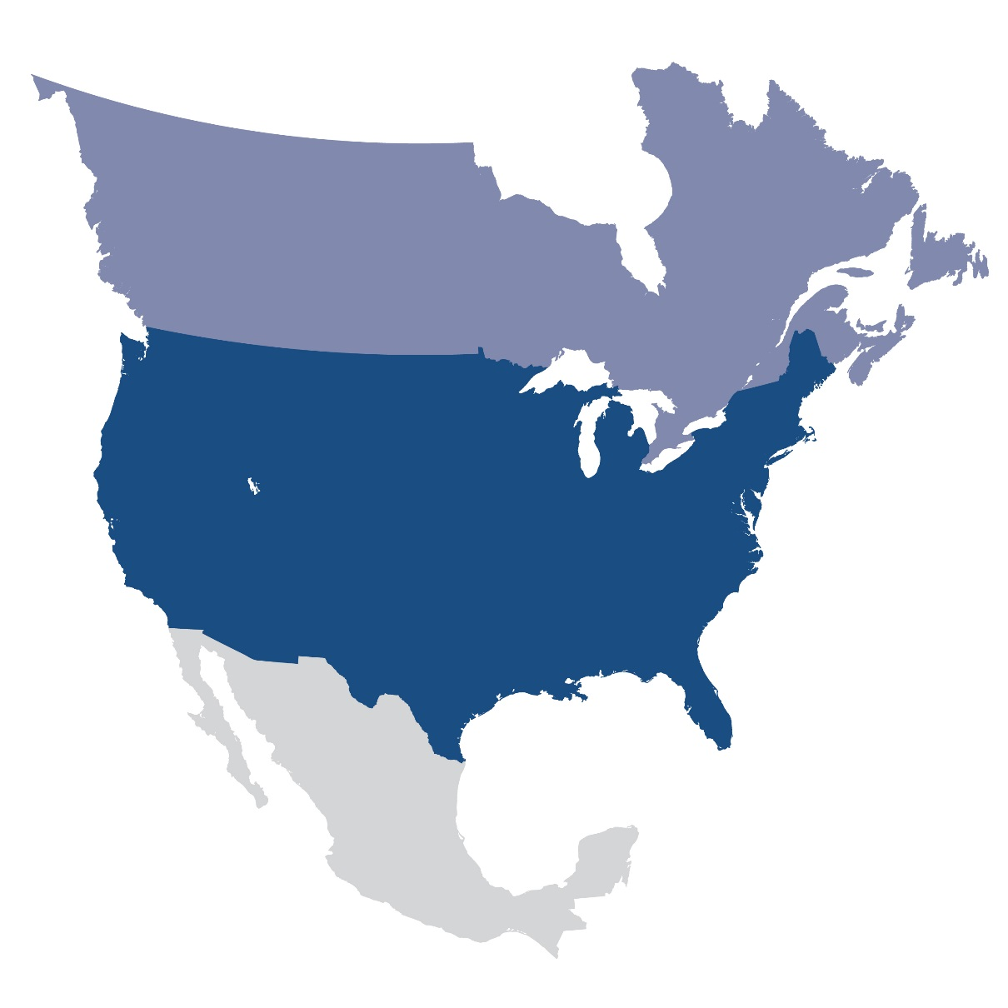
Questions and Answers

Slide 26

Summer Risk Assessment
MISO: Shortfall risk at high demand and low wind output
MRO-SaskPower: High generator outages can cause reserve shortages at peak demand
NPCC-New England: Generator retirements have reduced available capacity making the area more reliant on external transfers
Texas RE-ERCOT: Strong growth in load and solar resources is increasing energy risks and straining parts of the transmission network
WECC-British Columbia: Demand growth is and the effects of long-term drought on hydro generation threaten area reserves
WECC-California/Mexico: Wide-area heat events that threaten imports continue to pose energy risks (new and planned resources are improving the outlook)
Updated May 7, 2024
Seasonal Risk Assessment Summary
Elevated | Insufficient Operating Reserves in Extreme Conditions
Normal | Sufficient Operating Reserves
Extreme summer conditions include 90/10 demand scenarios, historical high generator outage rates, and low variable energy resource scenarios
WECC-Southwest: Demand growth and drought conditions can strain electricity supplies in extreme heat

Slide 27
2024 State of Reliability
Preliminary Key Items
Jack Norris, Engineer II
NERC Quarterly Technical Session
May 8, 2024

Slide 28
The State of Reliability: Objective
Provide objective, credible, and concise information to policy makers, industry leaders, and the NERC Board of Trustees on issues affecting the reliability and resilience of the North American bulk power system (BPS)
  Identify system performance trends and emerging reliability risks
  Determine the relative health of the interconnected system
  Measure the success of mitigation activities deployed
Evaluates the 2023 Operating Year and Historical Trends

Slide 29
Preliminary Key Findings
Severe, yet Routine, Weather Events Confirm Overall Resilience of BPS
Performance of Inverter-Based Resources (IBRs) Continues to Impact the BPS
Generation Forced Outage Rates Continue to Increase
Texas Interconnection Reliability Performance Improves while Facing New Challenges

Slide 30
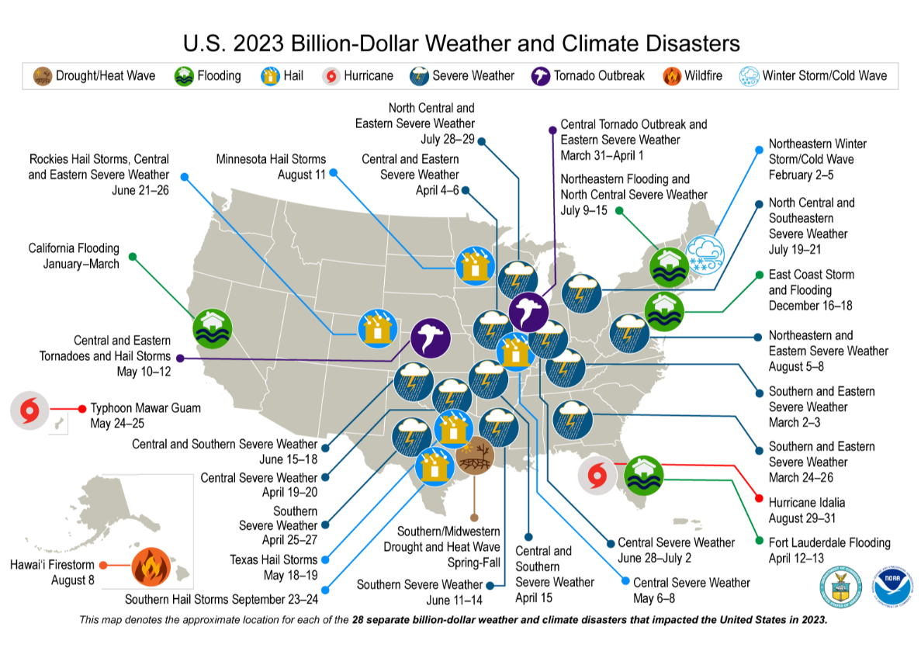
Severe, yet Routine, Weather Events Confirm Overall Resilience of BPS
28 Billion+ Dollar Weather Events in U.S.
Canadian Wildfires
No Events Analysis Disturbance Events at Category 3 or higher
No load unserved due to Level 3 Energy Emergency Alerts
Notes:
Major weather events in 2023 were widespread, primarily in the eastern interconnection, and not abnormal/extreme (i.e. it wasn’t 17 deg in Florida for a week and there wasn’t a cat 5 hurricane in Wisconsin). These types of events are what the BPS has been designed around for decades and as a result it performed very well.

Slide 31
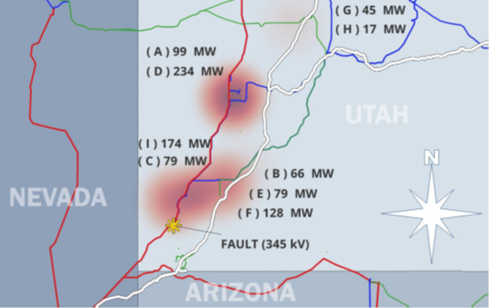
Inverter-Based Resources (IBRs) Performance Impact the BPS
Utah Solar PV Performance Improvement (2023)
CAISO Battery Storage System Disturbance (2022)
Texas Interconnection Battery Storage Supporting Frequency Response
Texas Interconnection IBR Ride-Through Performance Issues

Slide 32
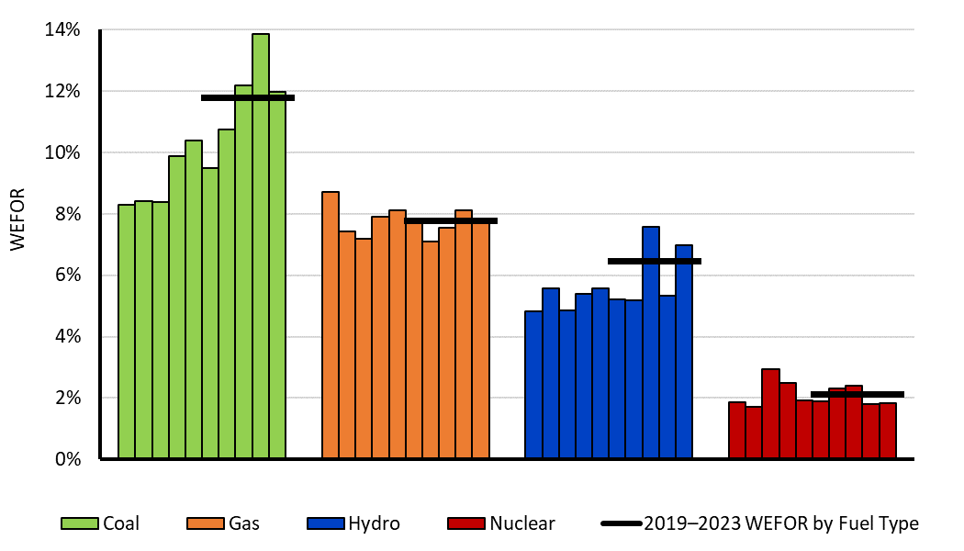
Generation Forced Outage Rates Continue to Increase
7.8% weighted equivalent forced outage rate (WEFOR)
Third worst on record
No major generation stressing events
Notes:
2023 was highest Weighted Equivalent Forced Outage Rate (WEFOR), except 2021 & 2022

Slide 33
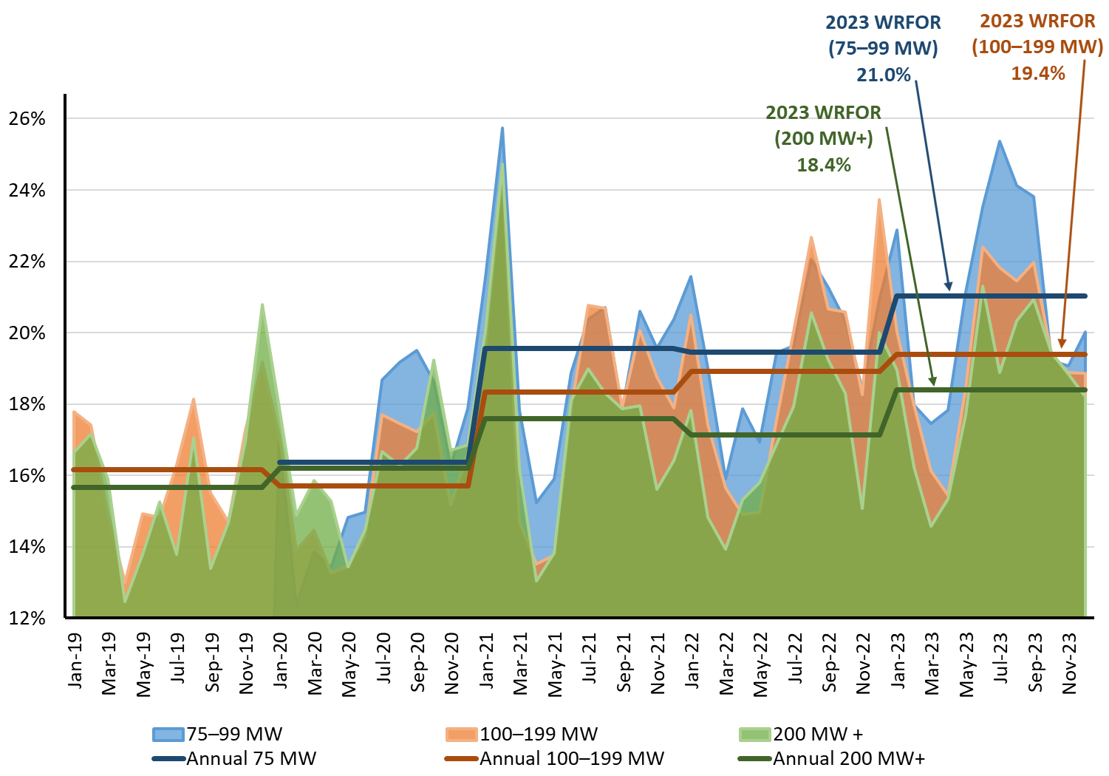
Generation Forced Outage Rates Continue to Increase
Wind weighted resource forced outage rate (WRFOR) up to 18.9%, highest since data collection began in 2018
More comprehensive wind & solar data collection begins in 2024

Slide 34
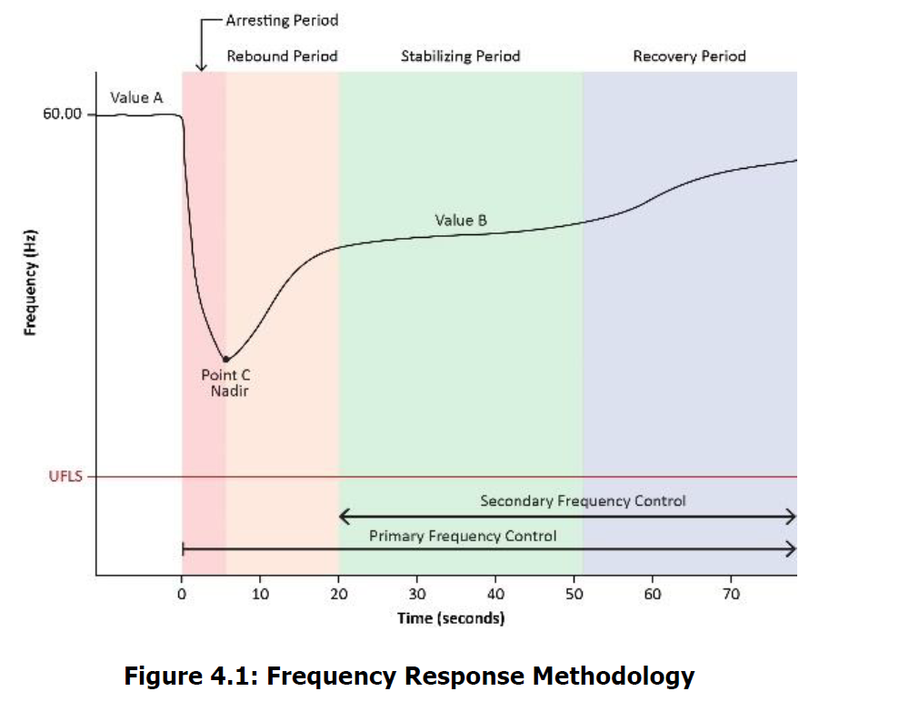
Texas Interconnection Frequency Response Improvements
Very high IBR penetration
Battery Energy Storage Systems
  Rapid response
  Ride-through performance failures
Improved frequency response

Slide 35
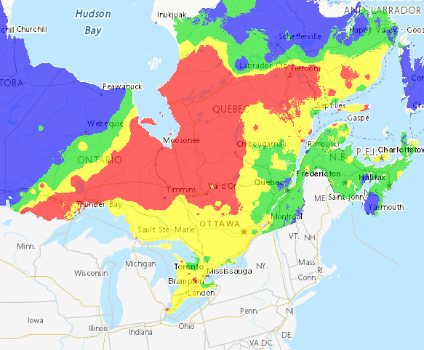
Key Occurrences
Québec Wildfires
16,674 square miles burned in Québec
Multiple high voltage outages
Remedial action scheme (RAS) 1800 MW shed
Average customer outage <1 hour
Utah Solar PV Performance Improvement
April 10; 929 MW of solar loss
September 29; 537 MW of solar loss

Slide 36
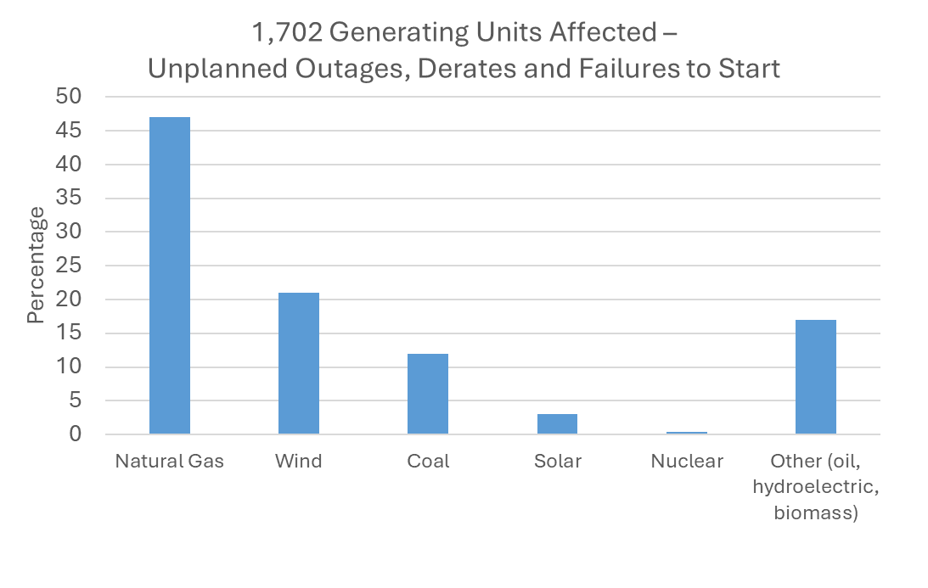
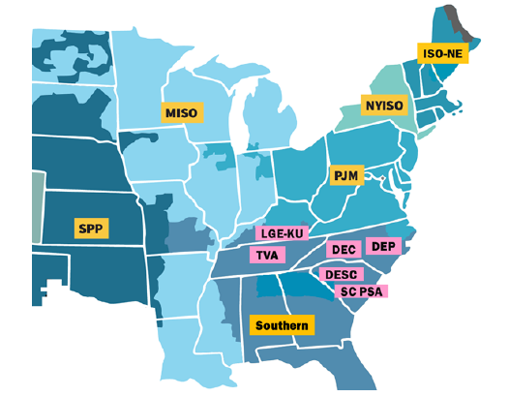
Winter Storm Elliott Report
Major Special Studies Released in 2023

Slide 37
CAISO Battery Storage System Disturbances
Major Special Studies Released in 2023
CAISO Battery Energy Storage System (BESS) Disturbance
  Two events involving BESS
    March 9, 2022
    April 6, 2022
  Main BESS causes
    Inverter AC overcurrent tripping
    Unbalanced AC current tripping
Notes:
CAISO ‘22: March 9 (1000MW) & April 6 (500MW)
BESS may have the same system performance problems as solar PV resources.
BESS ride-through performance is not adequately assessed during the interconnection process.
Poor commissioning practices are a significant contributor to the unreliable performance of IBRs.
NERC will be conducting a model quality assessment of this event and subsequently issue an alert as needed.
Lack of adequate monitoring hinders performance and event analysis.
CAP
Enhance inverter software upgrades. The software upgrades increased the threshold for dc bus unbalance tripping and faster activation of stronger dc balancing and low voltage ride-through mode. It should be noted that these enhanced facilities performed better during an event in February 2023 that involved an unbalanced grid fault.
CAISO updated its technical requirements of their pro forma LGIA , requiring the plant controller to be coordinated with the inverters so that that the plant controller doesn’t restrict inverter reconnection following the clearance of a low voltage transient.
Utah ‘23:
April 10 – 929MW solar lost, auto-restoration in 11 minutes, manual in 2 hours
September 29 – 537MW solar lost, auto-restoration in 7 minutes.
Utilities worked with manufacturers to improve tripping logic

Slide 38
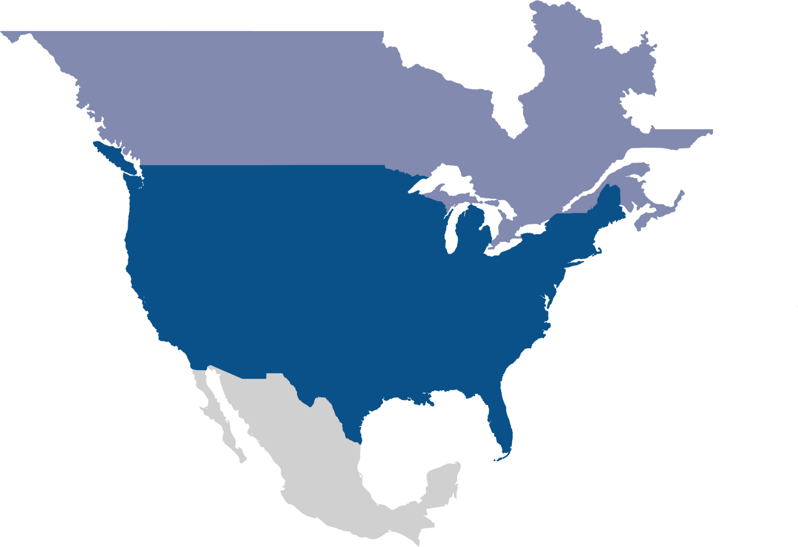
Questions and Answers

Slide 39
Interregional Transfer Capability Study (Update)
May 8, 2024
NERC Quarterly Technical Session
John Moura, Director, Reliability Assessment and Performance Analysis

Slide 40



Project Goals & Objectives
Comprehensive Study
Reliable and Data Driven
Stakeholder Engagement

Slide 41
ITCS Scope – Fiscal Responsibility Act 2023
Part I: Calculate current transfer capability
Part II: Recommend prudent additions to transfer capability
Part III: Recommend how to meet and maintain transfer capability

Slide 42






Project Status and Timeline
Final Report Submitted to FERC
Dec 2, 2024
Recommendations
August 2024
Analysis
July 2024
Data Gathering
Feb 2024
Study Prep and Approach
Jan 2024
Project Kickoff
July 2023

Slide 43
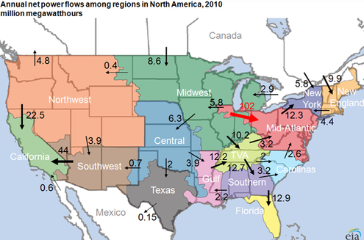
Study Workload
Part I Transfer Analysis
Part II Prudent Additions
Bi-Directional P2P Transfers
114
Weather Years
12
4
8760
Cases (summer peak, winter peak)
Hours
X
456
Individual Studies
~14,000
~100,000+
Individual Study Results

Slide 44
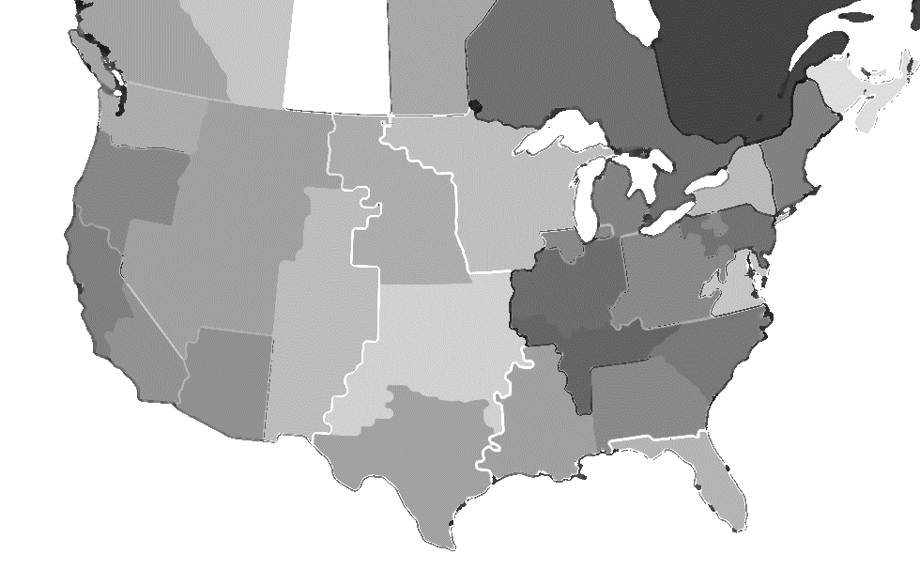
Pipe and Bubble Model
ITC determined in Part I (+/-)
Illustrative only
Colored by hourly energy margin (no ITC)
Represent DC interties

Slide 45
Pipe and Bubble Model
ITC determined in Part I (+/-)
Illustrative only
Colored by hourly energy margin (no ITC)
Colored by reliability flows
Represent DC interties

Slide 46
Energy Margin - Illustrative Example
Use this to measure relative scarcity in each region, and when to allow imports and exports
% of Load
Surplus
resources
(exports allowed)
Energy
Margin
(no interchange)
10%
Target Reserve Level
Resource scarcity
(no exports allowed,
imports if available)
Minimum Reserve Level
3%
Resource deficiency
Time (hrs)

Slide 47
Example of Benchmark Cold Weather Event (Future Year)
1. Interchange hours
2. Tight Margin hours
3. Scarcity Hours
Extreme weather event
→ One year of hourly data (2022) →
TEST RESULTS ONLY: USES PLACEHOLDER TRANSFER LIMITS

Slide 48
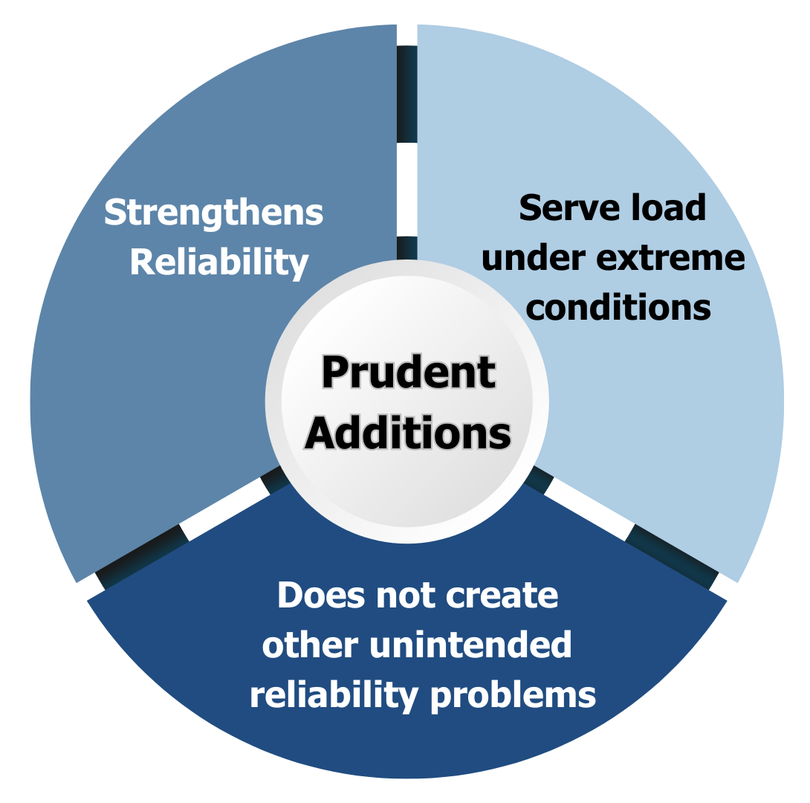
What is Technically Prudent Additions to Transfer Capability?
FERC precedent provides that “prudence” means a determination of whether a reasonable entity would have made the same decision in good faith under the same circumstances, and at the relevant point in time.
In more recent proceedings, FERC has described prudent decisions:
enhance ability to restore service;
achieve significant efficiencies;
reduce higher costs or time delays;
make efficient use of resources to ensure reliability of the transmission grid.

Slide 49
Method for prioritizing new ITC
How to prioritize which regions to use for ITC:
Assume a region uses its own resources first
(reliability rather than economic dispatch)
Prioritize nearby regions for support (neighboring Source/Sink)
Prioritize Source regions with more relative surplus
Tightening reserves within neighbor region
Tightening reserves within the region
Source: ESIG Transmission Resilience Task Force (Telos Energy)
https://www.esig.energy/transmission-resilience/
Proposal: Develop a method to prioritize which regions should increase ITC
Notes:
Each region will serve its own load prior to importing or exporting, which helps isolate reliability interchange rather than economic interchange.
(this is done by setting a high hurdle rate on ties between regions)
Operating costs are NOT assumed for resources
An operating constraint will increase “Scarcity Weighting Factor” in the region as margin gets tighter (model dispatch will be based on relative surplus/scarcity, not resource costs)
If a region cannot serve its own load, it will import from a neighbor that has relatively more surplus (lower scarcity weighting factor), subject to resource availability and tie-line capacity
While the hourly energy margin considers which regions have surplus during the times when another region is tight, additional consideration is required to determine how to prioritize new ITC.
Incremental Steps for Reliability Dispatch
Use own resources to serve load first. As region gets tighter, increase the relative scarcity factor.
When regions fall below 10% Target Reserve Level, import from neighbors. Decision on which neighbor to import from is based on their respective energy margin.
If sufficient imports are unavailable (due to line limits or lack of resources available) allow to go below the Target Reserve Level but maintain a 3% Minimum Reserve Level.
If sufficient resources are unavailable and energy reserves are fully utilized, then call out resource deficiency.
What this method DOES
Prioritize regions for interregional transfer capability
Tracks daily and hourly availability of all resource types
Calculates relative surplus and deficit in each region, at the same time
Performs a reliability-only dispatch of resources
Allows regions to import from one region while exporting to another
What this method DOES NOT
Represent actual physical power flows across the network
Track individual resource performance
Calculate relative costs or prices between regions
Perform an economic, least-cost (production cost) dispatch
Only evaluate “neighbor” flows

Slide 50

Part 3 Scope: Meet and Maintain
Additional studies and analysis
Infrastructure upgrades
Grid enhancing technologies
Resource additions
Markets & regulatory recommendations

Slide 51
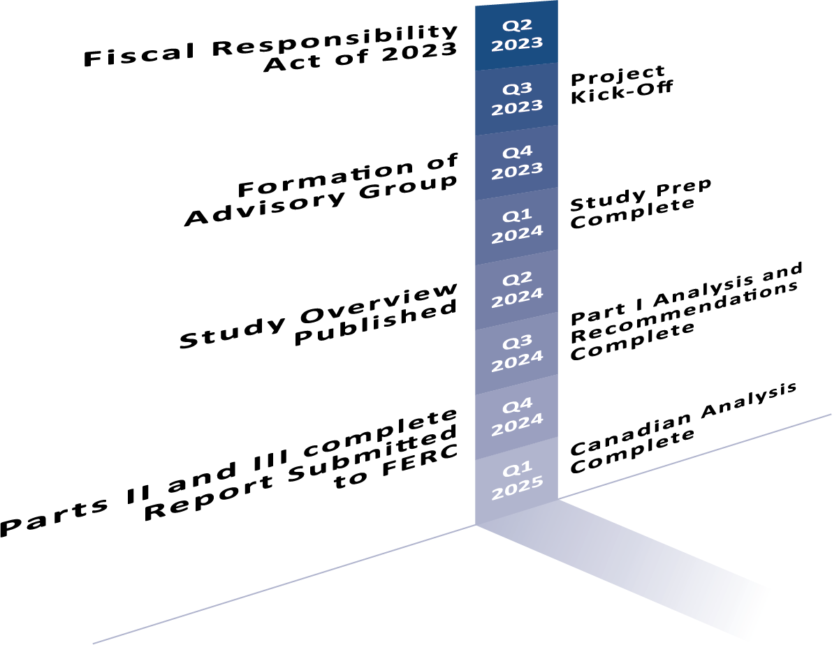
ITCS Timeline and Report Strategy

Slide 52
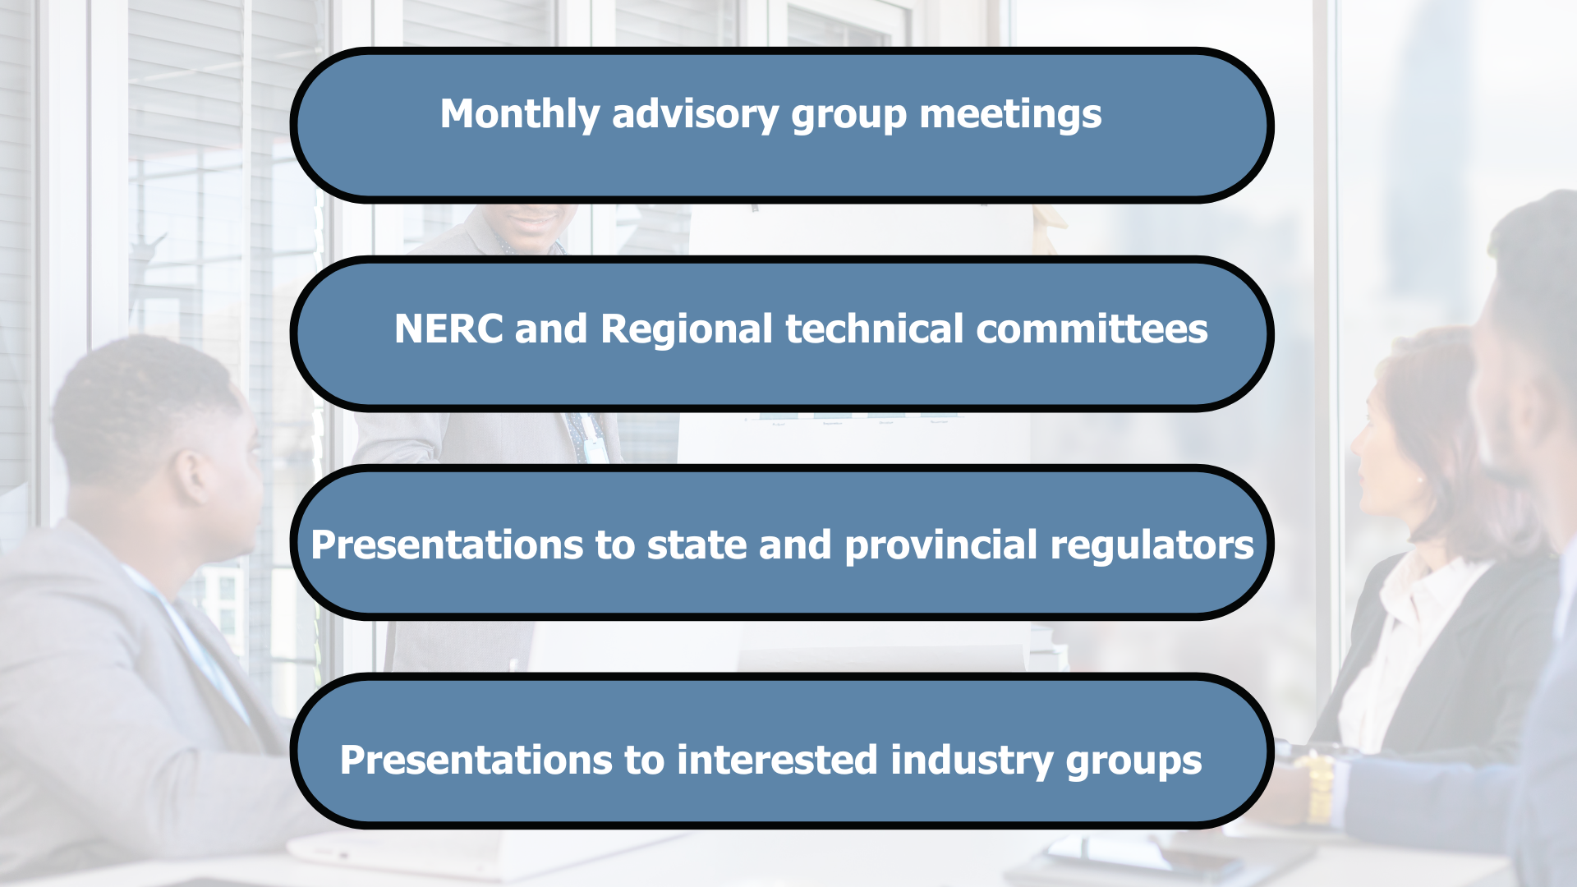
Stakeholder Input and Feedback Channels
ITCS Information is readily available on www.nerc.com
https://www.nerc.com/pa/RAPA/Pages/ITCS.aspx
itcs@nerc.net

Slide 53
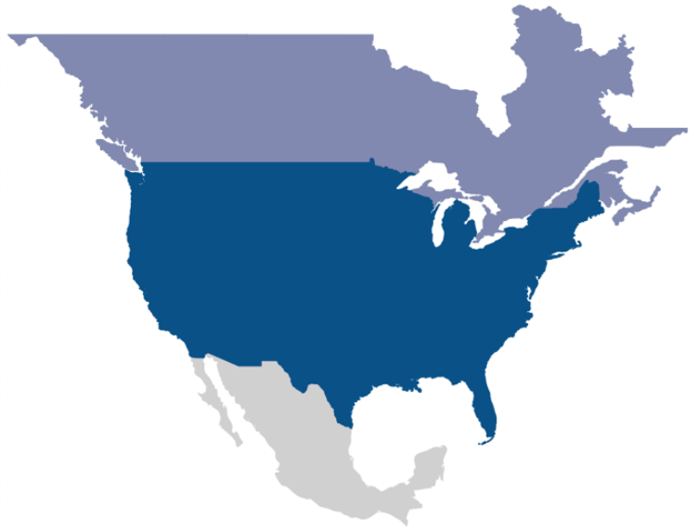
Questions and Answers

Slide 54
Bulk Power System Awareness
Situational Awareness Q2 2024
Darrell Moore, Director Situation Awareness and Personnel Certification/Credential Maintenance
NERC Quarterly Technical Session
May 8, 2024

Slide 55
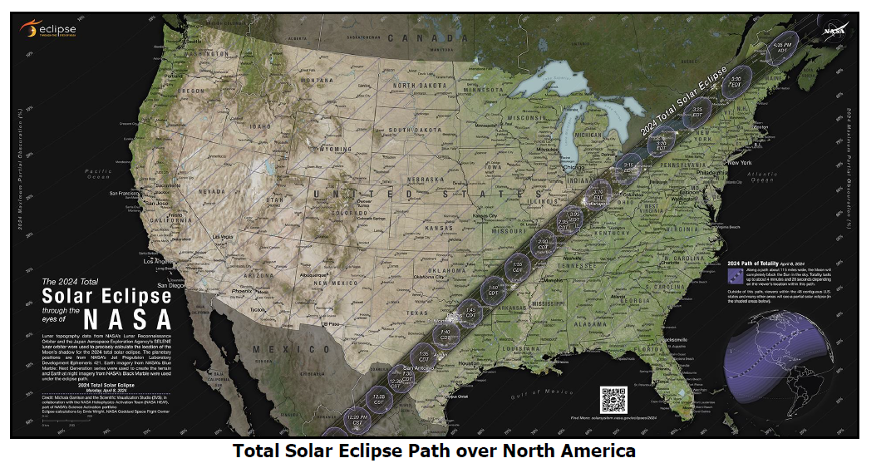
2024 Q2 Overview
For the first Quarter 2024, no widespread significant events were observed or reported on the North American Bulk Power System (BPS).
A total solar eclipse crossed North America on Monday April 8. Through proactive planning and posturing, system operators maintained bulk power system reliability during the event. There were no reported or observed impacts to the BPS.

Slide 56
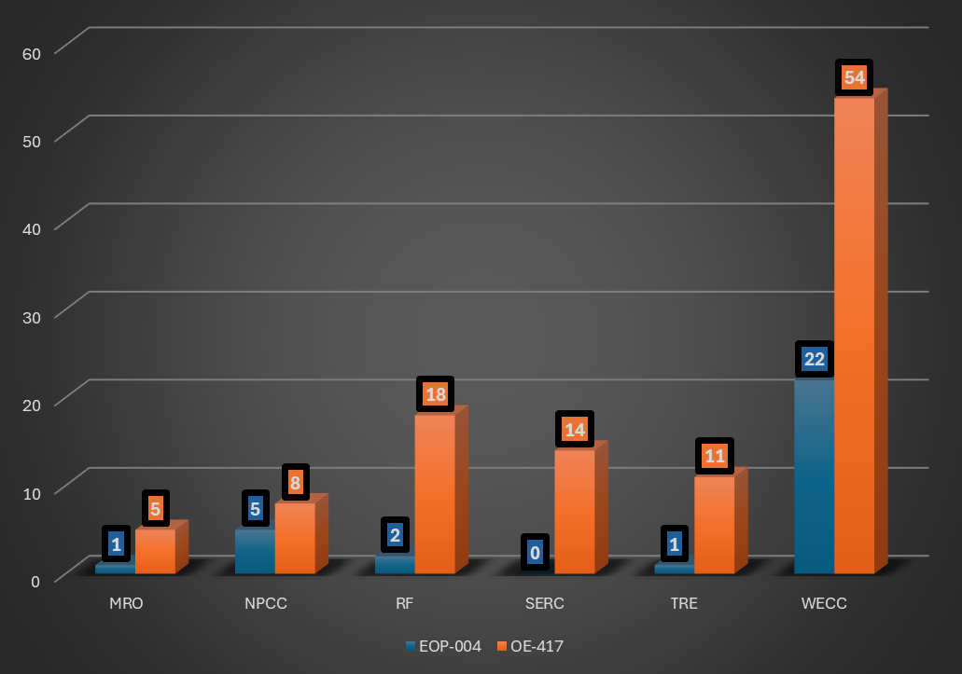
2024 Q1 Mandatory
Reports by Region
Notes:
Q1 2024 there were 141 mandatory reports submitted to NERC BPSA
31- EOP-004
110- OE-417
For awareness, NERC accepts OE-417 to satisfy the requirements of EOP-004 if the incident meets the requirements of both. These numbers do not reflect the total number of reports processed by BPSA, as entities often file multiple reports for an incident. For the purposes of this report, the duplicates have been counted as only one for each incident.,

Slide 57
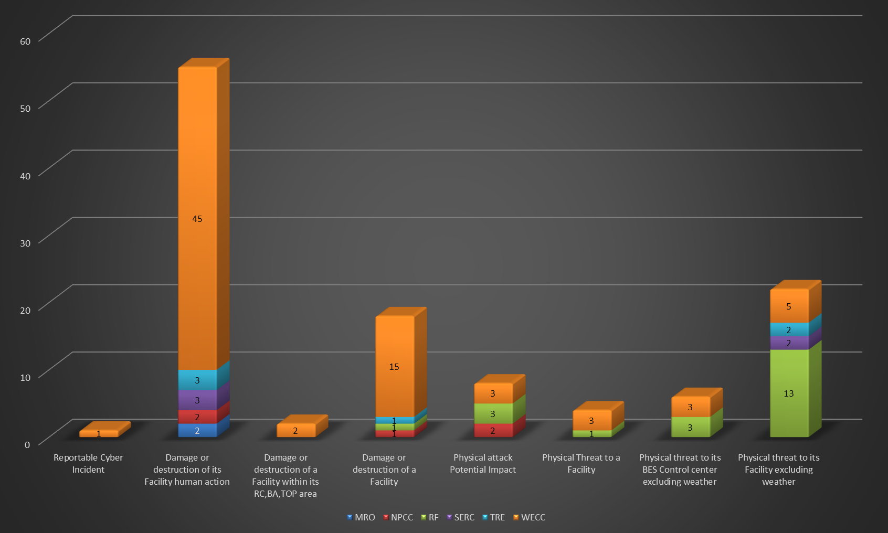
2024 Q1 Cyber & Physical Security
Reports by Region
Notes:
Of the 141 mandatory reports submitted to NERC BPSA in Q1 of 2024, 114 were physical security related and 1 were cyber related. The vast majority of the security related events this quarter were related to break in and theft of copper wire and tools.
3 of the 114 physical security events caused the removal of BES facilities as a direct result of the incident:
In California, 234 customers were put out of power when an SF6 breaker tripped due to gunfire damage
In California, a 115kV line was removed from service due to a single phasing condition. On Patrol a lock was found to be cut on a switch and 2 phases had been opened.
In Ontario, Canada, a 230kV circuit was forced out of service, due to attempted copper theft. The suspects attempted to strip ground wire from 26 wood poles with a vehicle. The grounds wire was found wrapped around the Skywire.
Cyber- In California, a wind turbine door was forced open and the intruders were able to access and remove networking equipment.

Slide 58
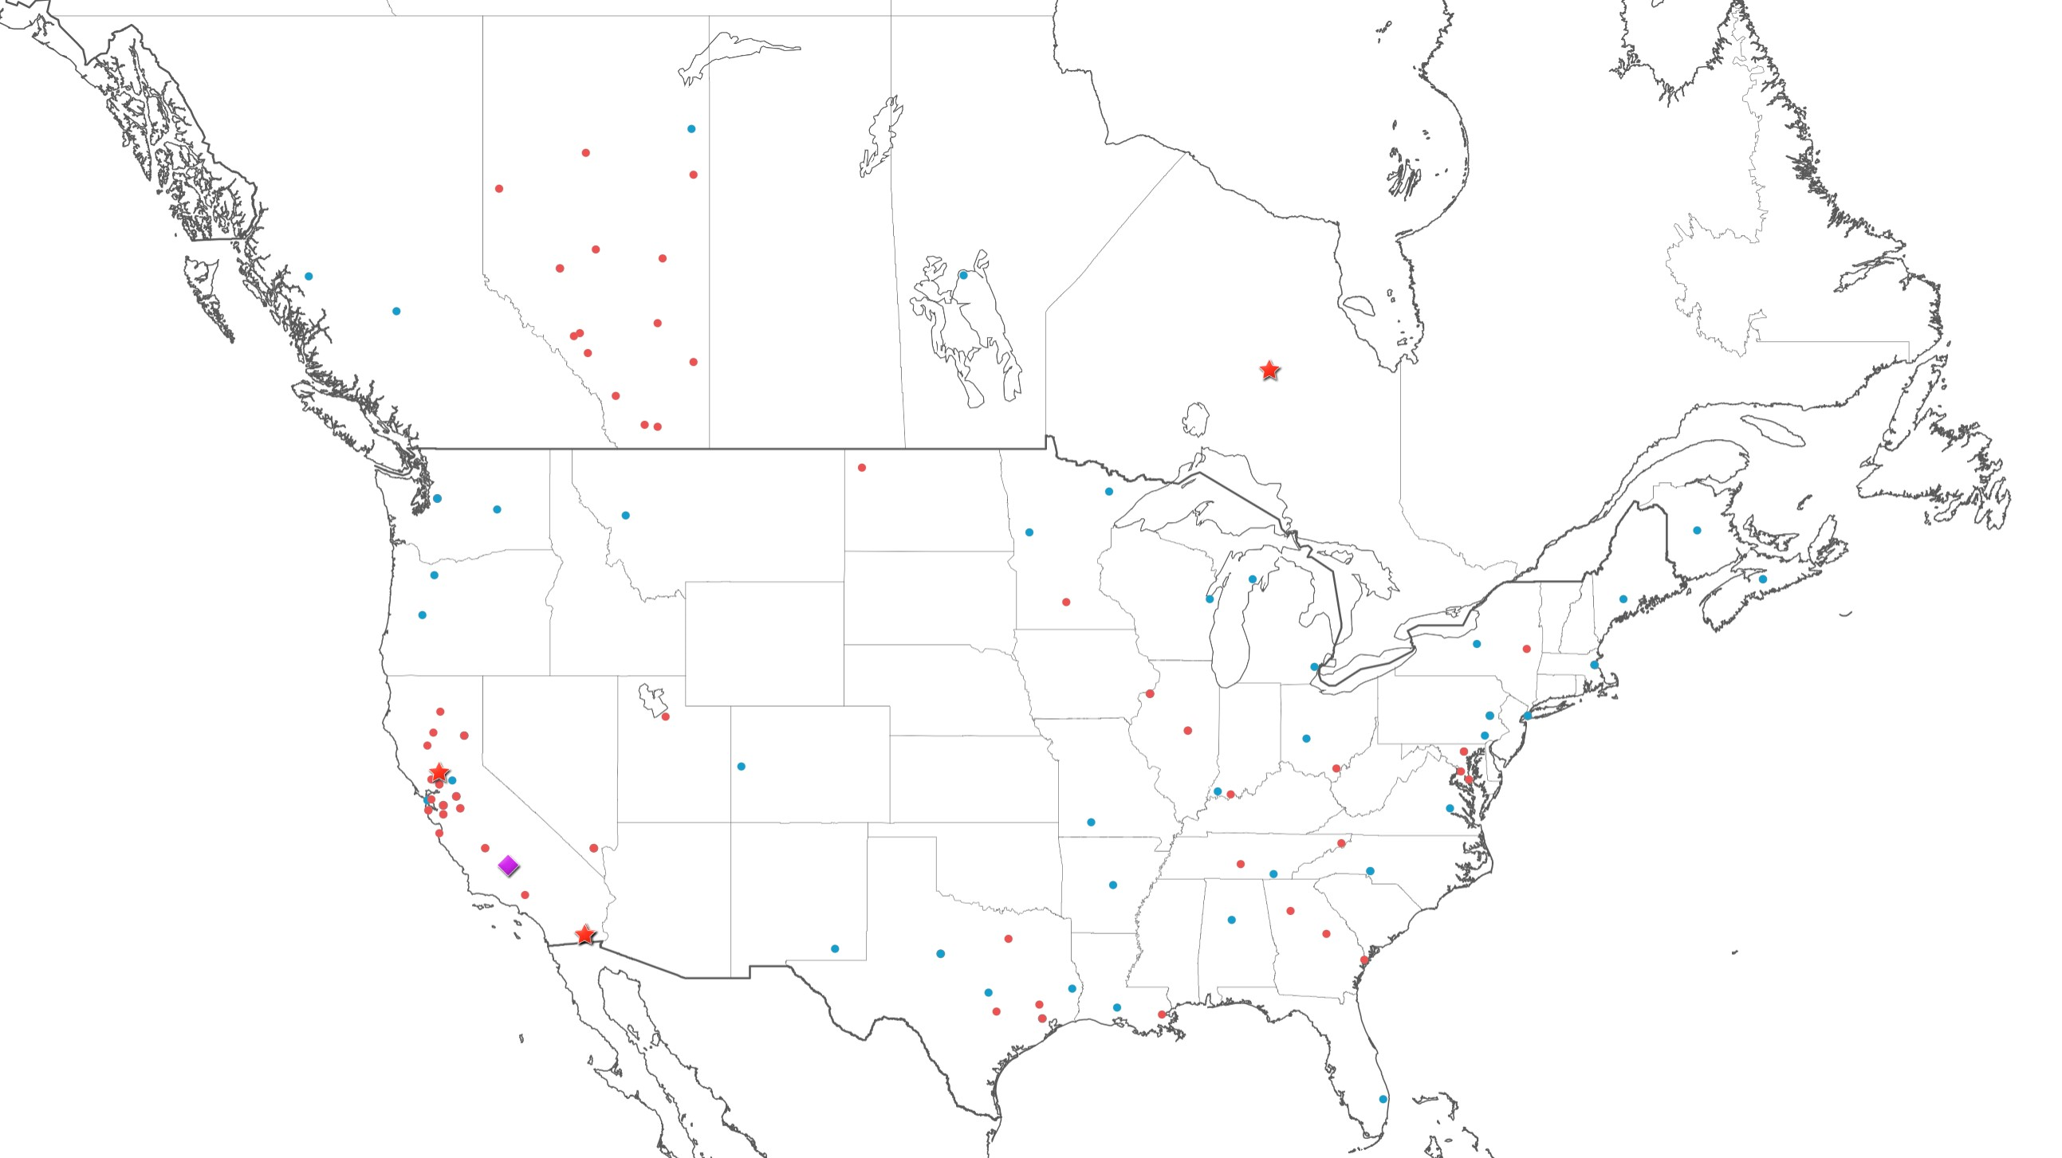

2024 Q1 Events
United States & Canada
Notes:
In California, 234 customers were put out of power when an SF6 breaker tripped due to gunfire damage
In California, a 115kV line was removed from service due to a single phasing condition. On Patrol a lock was found to be cut on a switch and 2 phases had been opened.
In Ontario, Canada, a 230kV circuit was forced out of service, due to attempted copper theft. The suspects attempted to strip ground wire from 26 wood poles with a vehicle. The grounds wire was found wrapped around the Skywire.
Cyber- In California, a wind turbine door was forced open and the intruders were able to access and remove networking equipment.

Slide 59

Energy Emergency Alert (EEA) 3
Reports 12 Month View
Notes:
There were 10 Energy Emergency Alerts (EEA3) declared across Q1. There were no firm load shed associated with these events.

Slide 60

Questions and Answers

Slide 61
Closing Remarks and Conclude Session

